Slide 1


Year 6
Curriculum Meeting

Slide 2
👋 Welcome to Our Year 6 Curriculum Meeting
Thank you for joining us today.
We’re delighted to have the opportunity to share key information about your child’s learning journey in Year 6.
Todays session will cover:
Curriculum highlights and expectations
How you can support learning at home
Routines of school

Slide 3
Mobile Phones
📱 Mobile Phone Use in School
School Policy:
Mobile phones should only be brought to school in emergencies.
If a phone is brought in, it must be:
  Switched off upon arrival
  Handed in to the school office for safe storage during the day

Slide 4
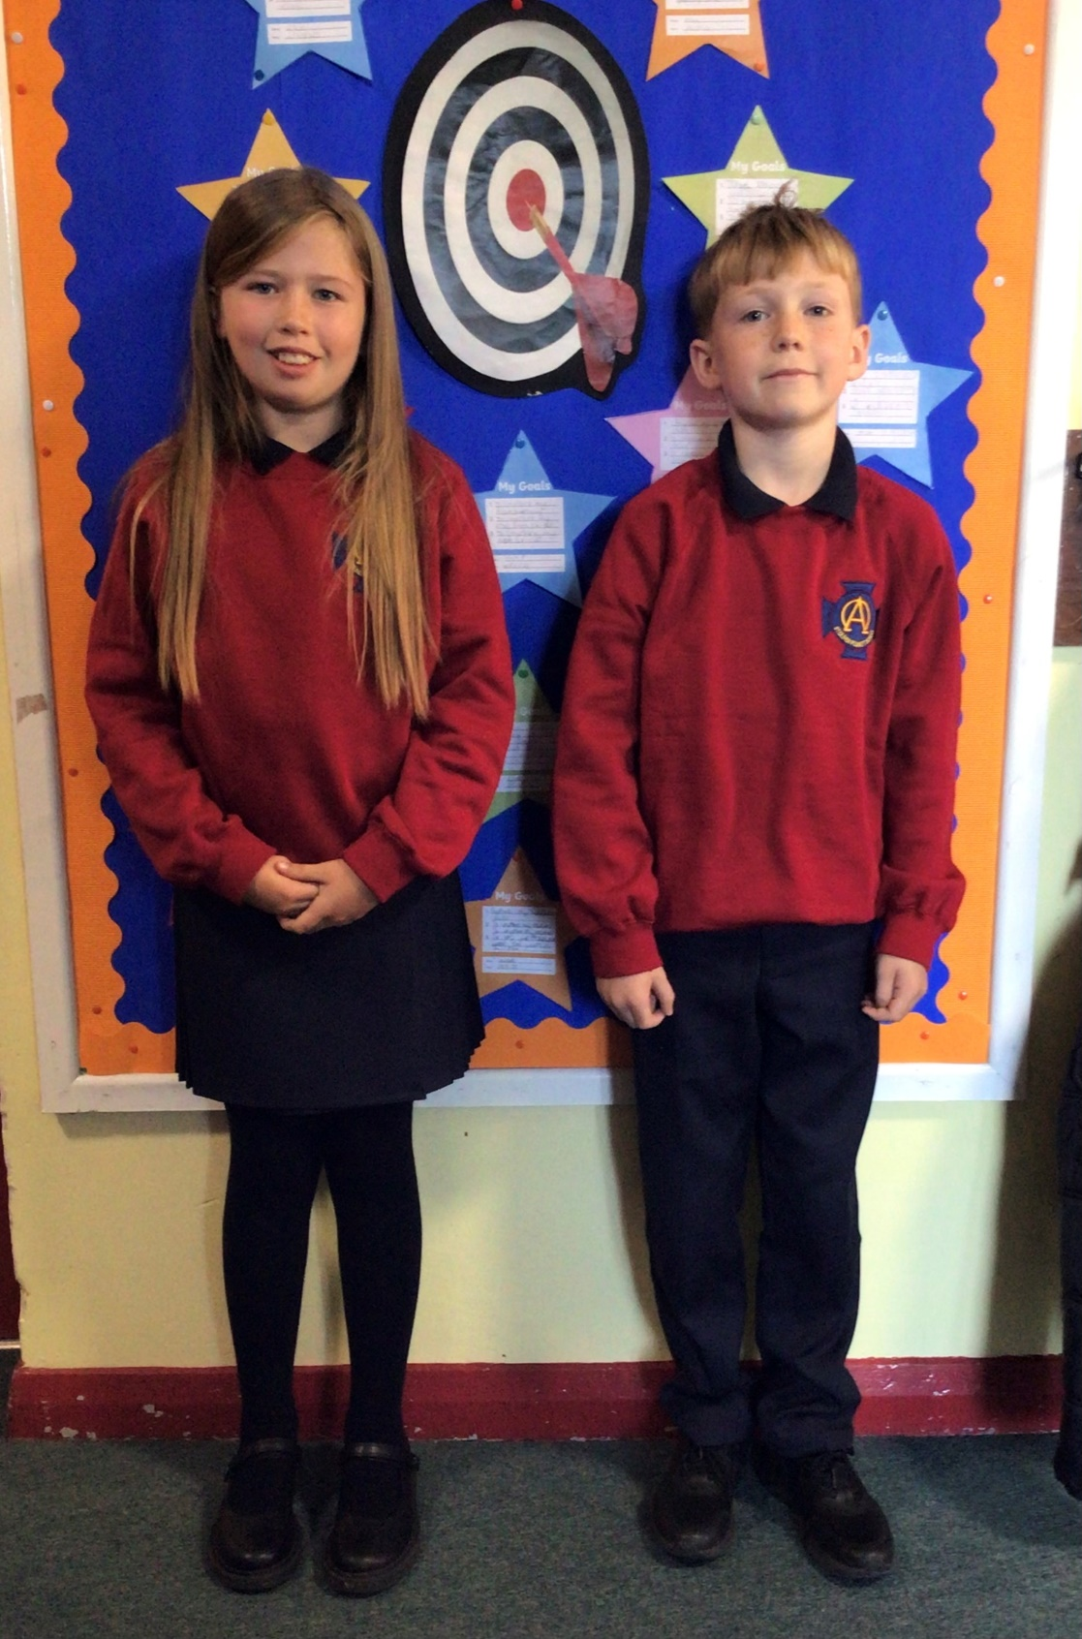

School Uniform
Please label everything.
Black shoes everyday.
Notes:
Rationale behind the development:
Mental Maths is an area for development within our school.
For years literacy has been the main focus, a successful focus.
As one of the new Numeracy Coordinators, I wanted to bring Mental Maths to the forefront of our school development.
Reasons why?
Mental Maths encourages actual understanding, not just memorisation.
Mental Maths is logical, it just makes sense.
Mental Maths is fun!
Mental Maths is a cross curricular skill.
And as CCEA clearly stated in the area of Using Mathematics "Across the curriculum, at a level appropriate to their ability, pupils should be enabled to:develop methods and strategies, including mental mathematics."
So we must provide our pupils with the opportunities to develop mathematical skills, mathematical strategies and mathematical knowledge.

Slide 5
Attendance
It is important that your child comes to school everyday.
If he/she is ill please phone to let the school know.
Please return the 'Absence Notification Form' to the class teacher.
Notes:
Why is Mental Computation so important
Mental computation is the foremost computational skill used in society.
More than 80% of all mathematical computations in daily life in love mental computation and estimation.
We are preparing children to be the workers of the future, we must give them every opportunity to be able to perform in tomorrow's society.

Slide 6
Punctuality
It is important that your child is in school by 8.45am.
Lessons start promptly at 8.55am.
Notes:
Why is Mental Computation so important
Mental computation is the foremost computational skill used in society.
More than 80% of all mathematical computations in daily life in love mental computation and estimation.
We are preparing children to be the workers of the future, we must give them every opportunity to be able to perform in tomorrow's society.

Slide 7






Break time
A healthy break is strongly encouraged in line with the school policy.
A sandwich with sugar free filling
fruit
Water or milk
No products containing nuts or coconut oil
Notes:
Why is Mental Computation so important
Mental computation is the foremost computational skill used in society.
More than 80% of all mathematical computations in daily life in love mental computation and estimation.
We are preparing children to be the workers of the future, we must give them every opportunity to be able to perform in tomorrow's society.

Slide 8
The Curriculum
Language and Literacy
Mathematics and Numeracy
The World Around Us
The Arts
Physical Education
PDMU (Personal Development & Mutual Understanding)
Religious Education
Notes:
Mental Computation
The role of mental computation is a way of allowing children to explore number and other mathematical concepts.
Flexible mental computation allows children to see beyond concrete representations
It allows them to develop their own strategies, ideas, reasoning and explanations.

Slide 9
Literacy
Pupils are developing skills in:
Talking and Listening
Reading (guided, shared and accelerated,
Suffolk Library)
Writing
Notes:
Areas for development identified with kS1 coord and principal
Those areas identified for development presented to staff during directed time - action plan shared and the way forward laid out for staff to see where we were going with Mental Maths
Making staff aware of the importance of Mental Maths development across the school and the curriculum through the dissemination of action plan and staff meetings.
Provision of on going support, guidance and training to staff in small groups, drop in workshop sessions, info sheets
Delegation of tasks across year bands to encourage staff to begin supporting each other
Regular meetings within key stages to provide ongoing support
Meetings with Tina Adair to seek support in delivery of Maths.

Slide 10
Grammar
Parts of Speech: Understanding nouns, verbs, adjectives, adverbs, pronouns, and prepositions.
Tenses: Using past, present and future tenses accurately.
Punctuation: Correct use of commas, apostrophes, speech marks and colons.
Grammar in Context: Applying grammar skills in creative and functional writing.

Slide 11
Writing Genres
Persuasive letter
Report (Newspaper & Non-Chronological)
Narrative (legends)
Poetry
Notes:
New Wave Mental Maths provided a range of levelled daily 5 minute maths exercise that coved all areas of mathematics.
Mathematical concepts
Number
Pre-algebra
Shape and Space
Measurement
Handling Data
Staff were quick to see how easily this new resource could be used. It was user friendly, just required some photocopying and was ready to use.

Slide 12
Numeracy
Number & Place Value: Reading, writing and comparing numbers up to 1 million, including rounding and negative numbers.
Calculations: Formal methods for addition, subtraction, multiplication and division, plus mental strategies and problem-solving.
Shape & Measure: Properties of 2D/3D shapes, angles, symmetry, coordinates, and converting units of measurement.
Time & Money: Reading timetables, solving time problems, budgeting and handling money in real-life contexts.
Data Handling: Collecting and interpreting data using charts and graphs; understanding averages.
Reasoning: Applying maths to everyday situations and explaining thinking clearly.
Notes:
The benefits of New Wave were that each week it introduced new area for development, that teachers would teacher on a Monday.
Across the it then reinforced previously taught concepts, thus keeping all areas fresh and in the pupils minds.
These exercises became part of daily homework. All provide by New Wave.
Then comes Friday as we all know is Test day. New Wave provide a Friday test each week assessing what has been coved during the week.
Teachers have found New Wave provides continuity and progression can be differentiated when necessary, easy to use, manageable, easy to assess and child friendly.
It

Slide 13
Basic skills
Children will move classes one lesson per week.
We can differentiate 4 ways and have quality teaching time with children of similar ability.

Slide 14
The Arts
Music – using Charanga music programme
Art – we use ‘Art Time Let’s Shine’ programme for watercolour painting but we do lots of art around our topics using various mediums.

Slide 15
World Around Us
Terms | Topics
Term 1 | Natural Disasters
Term 2 | World World 2
Term 3 | Titanic

Slide 16
Religion
Grow in Love.
Monthly School Mass.
Class mass throughout the year.
Hymn practice for various services.

Slide 17

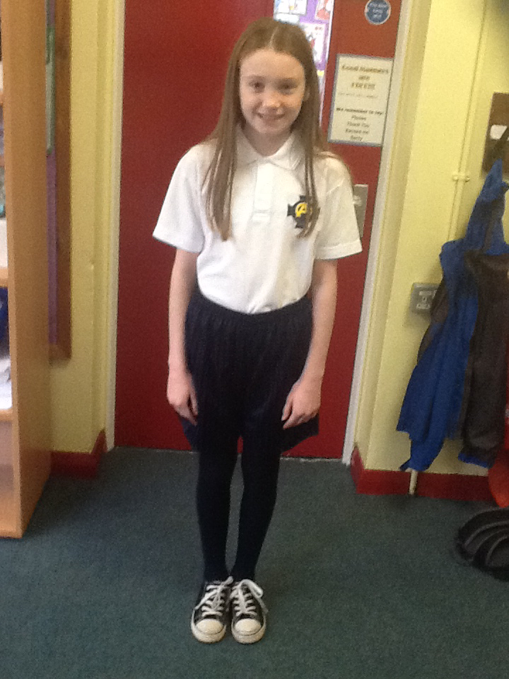
PE
Full PE uniform – labelled and on PE days only.
Swimming – 2 blocks, £3.00 per week.
Following CORE Kids programme.
- Gymnastics
- Games
- Athletics
Coaches throughout the year.

Slide 18
Homework
Monday | Comprehension
Tuesday | New Wave Mental Maths x2
Wednesday | Grammar
Thursday | New Wave Mental Maths x2
Nightly | Spelling
 | Times Tables/Maths Facts
 | Reading Reading Book/Novel
CHECK and SIGN homework nightly.

Slide 19
Parent Teacher
Meeting
Individual Parent/Teacher meeting during month of November.
In accordance with school policy please make an appointment through the office if you wish to speak to the class teacher.

Slide 20
SEAG Entrance Assessment – Key Information
Purpose: Used by many post-primary schools in Northern Ireland as part of their admissions criteria.
IS IT RIGHT FOR YOUR CHILD?
Assessment Date: Typically held in November of the P7 year.
Registration: Opens in May and closes in September of the same year.
Format: Two papers covering English and Mathematics, aligned with the NI Curriculum.
Preparation: 2x tests weekly (starting February) & weekend homework.
- Transfer Together access.
Assessment Centres: Parents choose a centre during registration — early registration offers more choice.
Results: Issued in January, ahead of the post-primary application process.

Slide 21
Thank you for
coming!
Notes:
It is hoped that the Action Plan for Mental Maths will be a success.
The good practice of involving Mental Maths within learning and teaching will be embedded.
That the introduction of New Wave Mentals will be successful in raising pupils' confidence in mathematics and that this is reflected in End of Key Stage Results and in Nfer testing.
If successful in Years 5 to 7 New Wave homework will be introduced into Year 4.

