Slide 1


Year 7
Curriculum Meeting

Slide 2
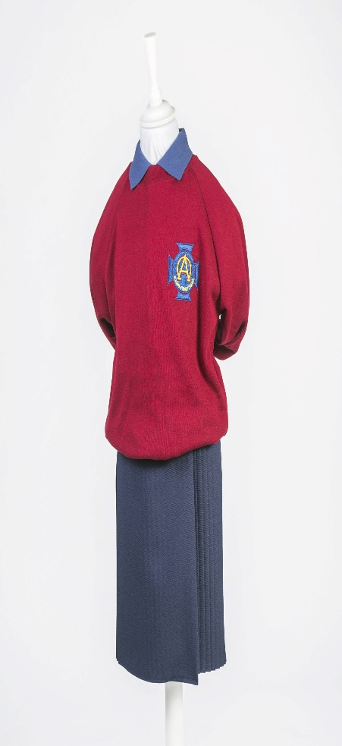
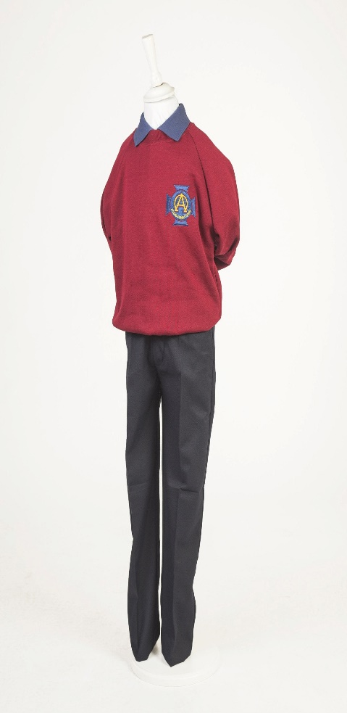

School Uniform
Please label everything.
Black shoes everyday.
PE gear can be worn on PE days and for children who attend sporting afterschools.
No jewellery/make up.
Notes:
Rationale behind the development:
Mental Maths is an area for development within our school.
For years literacy has been the main focus, a successful focus.
As one of the new Numeracy Coordinators, I wanted to bring Mental Maths to the forefront of our school development.
Reasons why?
Mental Maths encourages actual understanding, not just memorisation.
Mental Maths is logical, it just makes sense.
Mental Maths is fun!
Mental Maths is a cross curricular skill.
And as CCEA clearly stated in the area of Using Mathematics "Across the curriculum, at a level appropriate to their ability, pupils should be enabled to:develop methods and strategies, including mental mathematics."
So we must provide our pupils with the opportunities to develop mathematical skills, mathematical strategies and mathematical knowledge.

Slide 3
Attendance
It is important that your child comes to school everyday.
If he/she is ill please phone to let the school know.
Please return the 'Absence Notification Form' to the class teacher.
Notes:
Why is Mental Computation so important
Mental computation is the foremost computational skill used in society.
More than 80% of all mathematical computations in daily life in love mental computation and estimation.
We are preparing children to be the workers of the future, we must give them every opportunity to be able to perform in tomorrow's society.

Slide 4
Punctuality
It is important that your child is in school by 8.45am.
They will be collected from their lines at this time.
Lessons start promptly at 8.45am.
Notes:
Why is Mental Computation so important
Mental computation is the foremost computational skill used in society.
More than 80% of all mathematical computations in daily life in love mental computation and estimation.
We are preparing children to be the workers of the future, we must give them every opportunity to be able to perform in tomorrow's society.

Slide 5

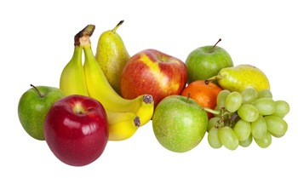




Break time
A healthy break is strongly encouraged in line with the school policy.
A piece of fruit/veg
A sandwich with sugar free filling
Water or milk
Absolutely no nuts.
No flavoured/
Fizzy water
Notes:
Why is Mental Computation so important
Mental computation is the foremost computational skill used in society.
More than 80% of all mathematical computations in daily life in love mental computation and estimation.
We are preparing children to be the workers of the future, we must give them every opportunity to be able to perform in tomorrow's society.

Slide 6
The Curriculum
Language and Literacy
Mathematics and Numeracy
The World Around Us
The Arts
Physical Education
PDMU
Religious Education- Grow in Love
RSE- Flourish Programme
Notes:
Mental Computation
The role of mental computation is a way of allowing children to explore number and other mathematical concepts.
Flexible mental computation allows children to see beyond concrete representations
It allows them to develop their own strategies, ideas, reasoning and explanations.

Slide 7
Writing Genres
Balanced Reports
Explanation
Biographical Recount
Narrative
Notes:
New Wave Mental Maths provided a range of levelled daily 5 minute maths exercise that coved all areas of mathematics.
Mathematical concepts
Number
Pre-algebra
Shape and Space
Measurement
Handling Data
Staff were quick to see how easily this new resource could be used. It was user friendly, just required some photocopying and was ready to use.

Slide 8
Numeracy
Constant reinforcement and extension of NUMBER work, increasing in level of difficulty and incorporating real-life problem solving.
SHAPE, SPACE AND MEASURE properties of 2d and 3d shape. Perimeter, area, volume,axis of symmetry, length, weight and capacity.
DATA HANDLING variety of diagrams, bar charts, line graphs, pie charts, venn diagrams. interpreting and creating them.
Problem Solving- Basic Skills, Izak 9
Notes:
The benefits of New Wave were that each week it introduced new area for development, that teachers would teacher on a Monday.
Across the it then reinforced previously taught concepts, thus keeping all areas fresh and in the pupils minds.
These exercises became part of daily homework. All provide by New Wave.
Then comes Friday as we all know is Test day. New Wave provide a Friday test each week assessing what has been coved during the week.
Teachers have found New Wave provides continuity and progression can be differentiated when necessary, easy to use, manageable, easy to assess and child friendly.
It

Slide 9
Literacy
AR
We encourage all children to join their local library. Suffolk Library.

Slide 10
World Around Us
Terms | Topics | Skills
Term 1 | Victorians | Independent Project Work
Term 1 | The Human Body | Research based
Term 2 | Romans | Transferable Skills
Term 2 | Irish History- A brief overview | Pupil led learning
Term 3 | Transition Through to Secondary

Slide 11
The Arts
Music – Charanga, School show
Art - working with different Medium, clay, chalk, charcoal etc, Art and Design Factory.
Drama –School show!

Slide 12
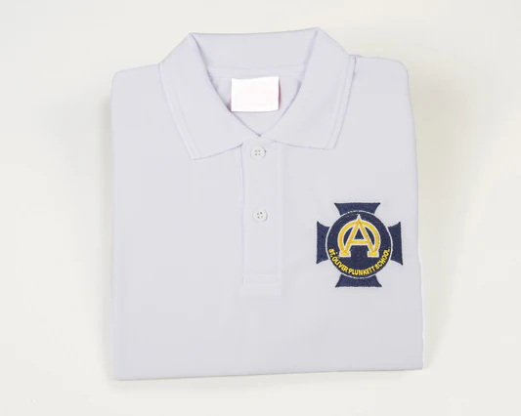
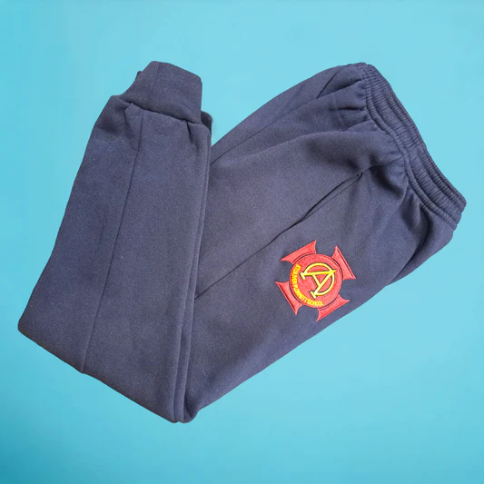
PE
Full PE uniform - labelled
Swimming - After Halloween £3.00 per week
Handball coaching
PE Curriculum- Gymnastics and Dance through CORENI

Slide 13
PDMU
PDMU Programme for Year 7. Living, Learning, Together. http://www.nicurriculum.org.uk/curriculum_microsite/pdmu/living_learning_together/home.asp Unit 5: Says who? Unit 1: What makes me, me? Unit 2: Thinking and Feeling. Unit 3: Fit for the Future. Unit 4: Moving On. Unit 6: Who Cares? Unit 7: New Horizons. CoreNi Meditation

Slide 14
Religion
Theme 1 – God is Always With Us | God Knows us and Loves us God Speaks to Us Through the Bible The Prophets Speak the Word of God
Theme 2 – Jesus | The Parable of the Workers in the Vineyard Jesus the Healer “Who do you say I am?”
Theme 3 – Our Christian Vocation | God Calls Each One of Us We Respond to God’s Call
Theme 4 – Advent and Christmas | 1.Zacheriah Waits 2. Joseph Waits 3. Christians Believe in The Birth of Jesus
Theme 5 – Conscience | We Can Hear God’s Voice Within Us Our Conscience Develops As We Grow
Theme 6 – Social Justice | Jesus Teaches Us To Act Justly Jesus Teaches Us The Beatitudes We Are Called to Our Common Home
Theme 7 – Holy Week and Easter | Walking In The Footsteps Of Jesus My Lord And My God Jesus’ Work Continues Today
Theme 8 – The Holy Spirit | The Holy Spirit The Gifts Of The Holy Spirit Come Holy Spirit Living A Spirit
Theme 9 – We Are Called to Love and Serve the Church | Exploring Our Diocese The Sacrament of Holy Orders
Theme 10 – The Mass | On The Road To Emmaus The Table Of The Lord
Theme 11: Music for the Mass | Music For The Mass
Theme 12: Seasonal Material | Death and Eternal Life Lent St Patrick Mary Mother of Jesus Judaism Judaism
YEAR SEVEN - GROW IN LOVE

Slide 15
Confirmation and Service of Light
Service of Light: 9th December 2025 - 1.15pm
Confirmation: TBC
Discuss the saint’s name they wish take and for what reason.
Further details will be sent closer to the time.
Encourage at home - songs, prayers, gifts and fruits of the Holy Spirit etc

Slide 16
RSE Curriculum
Year 7 | Myself Emotions and Relationships (KS2 Th 2 Feelings and Emotions St 1 their management of a range of feelings and emotions and the feelings and emotions of others) Myself and Others Love (KS2 Th 5 Relationships St 2 initiating and sustaining mutually satisfying relationships) Myself and the Wider World Safe Internet (Th 4A Safety St 1 coping safely and efficiently with their environment) What’s Inside? Workshop will take place for all P7 students. (KS2 Th 4: Health, Growth and Change: Strand 1 how to sustain their health, growth and well-being.)
*** Theme and Strand from DENI Statutory Minimum Requirements for Relationships and Sexuality Education noted beside each lesson***

Slide 17
Homework
Monday | Literacy grammar books – Mental Maths New Wave
Tuesday | Literacy grammar books – Mental Maths New Wave
Wednesday | Literacy grammar books – Mental Maths New Wave
Thursday | Literacy grammar books – Mental Maths New Wave
Nightly | Spelling
 | New Wave Mental Maths New
 | Reading Reading Book/Novel
CHECK and SIGN homework nightly
Transfer extra work.

Slide 18
Mobile Phones
Children should not bring mobile phones and if you wish to contact them please phone the office.
If your child MUST bring a mobile phone then it must turned off and left at the office.

Slide 19
Communication
If you wish to contact or discuss any issue with the class teacher then please make an appointment with the school office.
Teachers are not available during teaching hours and if a change to collection is needed let the office know.

Slide 20
End of Year Arrangements
Year 7 School Show – 10th and 11th June 2026. More details to follow.
Year 7 End of Year Trip- Lets Go Hydro- Date to be confirmed in new year.
End of Year Presentation- More details to follow.
Leavers Hoodies - fundraiser

