Slide 1
Numeracy

Slide 2



Number
Number to 20
Counting to 100
Addition
Practical subtraction
Work within 20
Count orally to 100
Children are made aware of the numbers to 100 and what they look like through games like bingo
We begin to introduce addition practically, within 5 then within 10
In term 3, the children will be completing horizontal addition sums
We introduce the concept of subtraction, practically in term 3
Notes:
Work within 20
Count orally to 100 and children are made aware of the numbers to 100 and what they look like through games like bingo and snakes and ladders
We begin to introduce addition practically, within 5 then within 10.
In term 3, the children will be completing horizontal addition sums.
We introduce the concept of subtraction, practically in term 3.

Slide 3


Time
Sequencing of routines
Days of week
Months of year
o'clock
We focus on sequencing events, such as a daily routine, our daily timetable
We move on to special times on the clock like break time, lunch time, home time
Then progress on to o’clock
Daily repetition of days of the week and months of the year
Notes:
We focus on sequencing events, such as a daily routine, our daily timetable.
We move on to special times on the clock like break time, lunch time, home time
Then progress on to o'clock
Daily repetition of days of the week and months of the year.

Slide 4
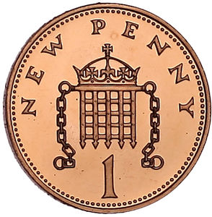

Money
Shopping experiences through role play
Shopping with 1p, 2p and 5p coins
Children are encouraged to use the language of money in shopping activities during role play in the classroom
Revise shopping with pennies and then introduce 2p then 5p coins
Carry out shopping activities to 10p and beyond with those children who have a good solid grasp of money
Notes:
Children are encouraged to use the language of money in shopping activities during role play in the classroom.
We revise shopping with pennies and then introduce 2p then 5p coins. We carry out shopping activities to 10p and beyond with those children who have a good solid grasp of money.

Slide 5
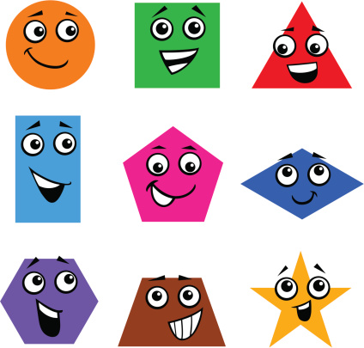
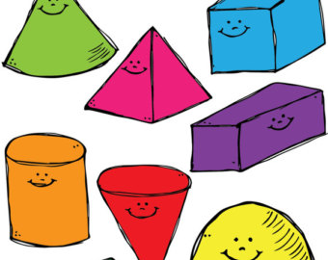
Shape and Space
Revise 2D shapes
3D shapes
We revise the 2D shapes and move onto 3D shapes and their properties. Children are encouraged to use 3D shapes in their play, in construction and in junk modelling.
Notes:
We revise the 2D shapes and move onto 3D shapes and their properties. Children are encouraged to use 3D shapes in their play, in construction and in junk modelling

Slide 6
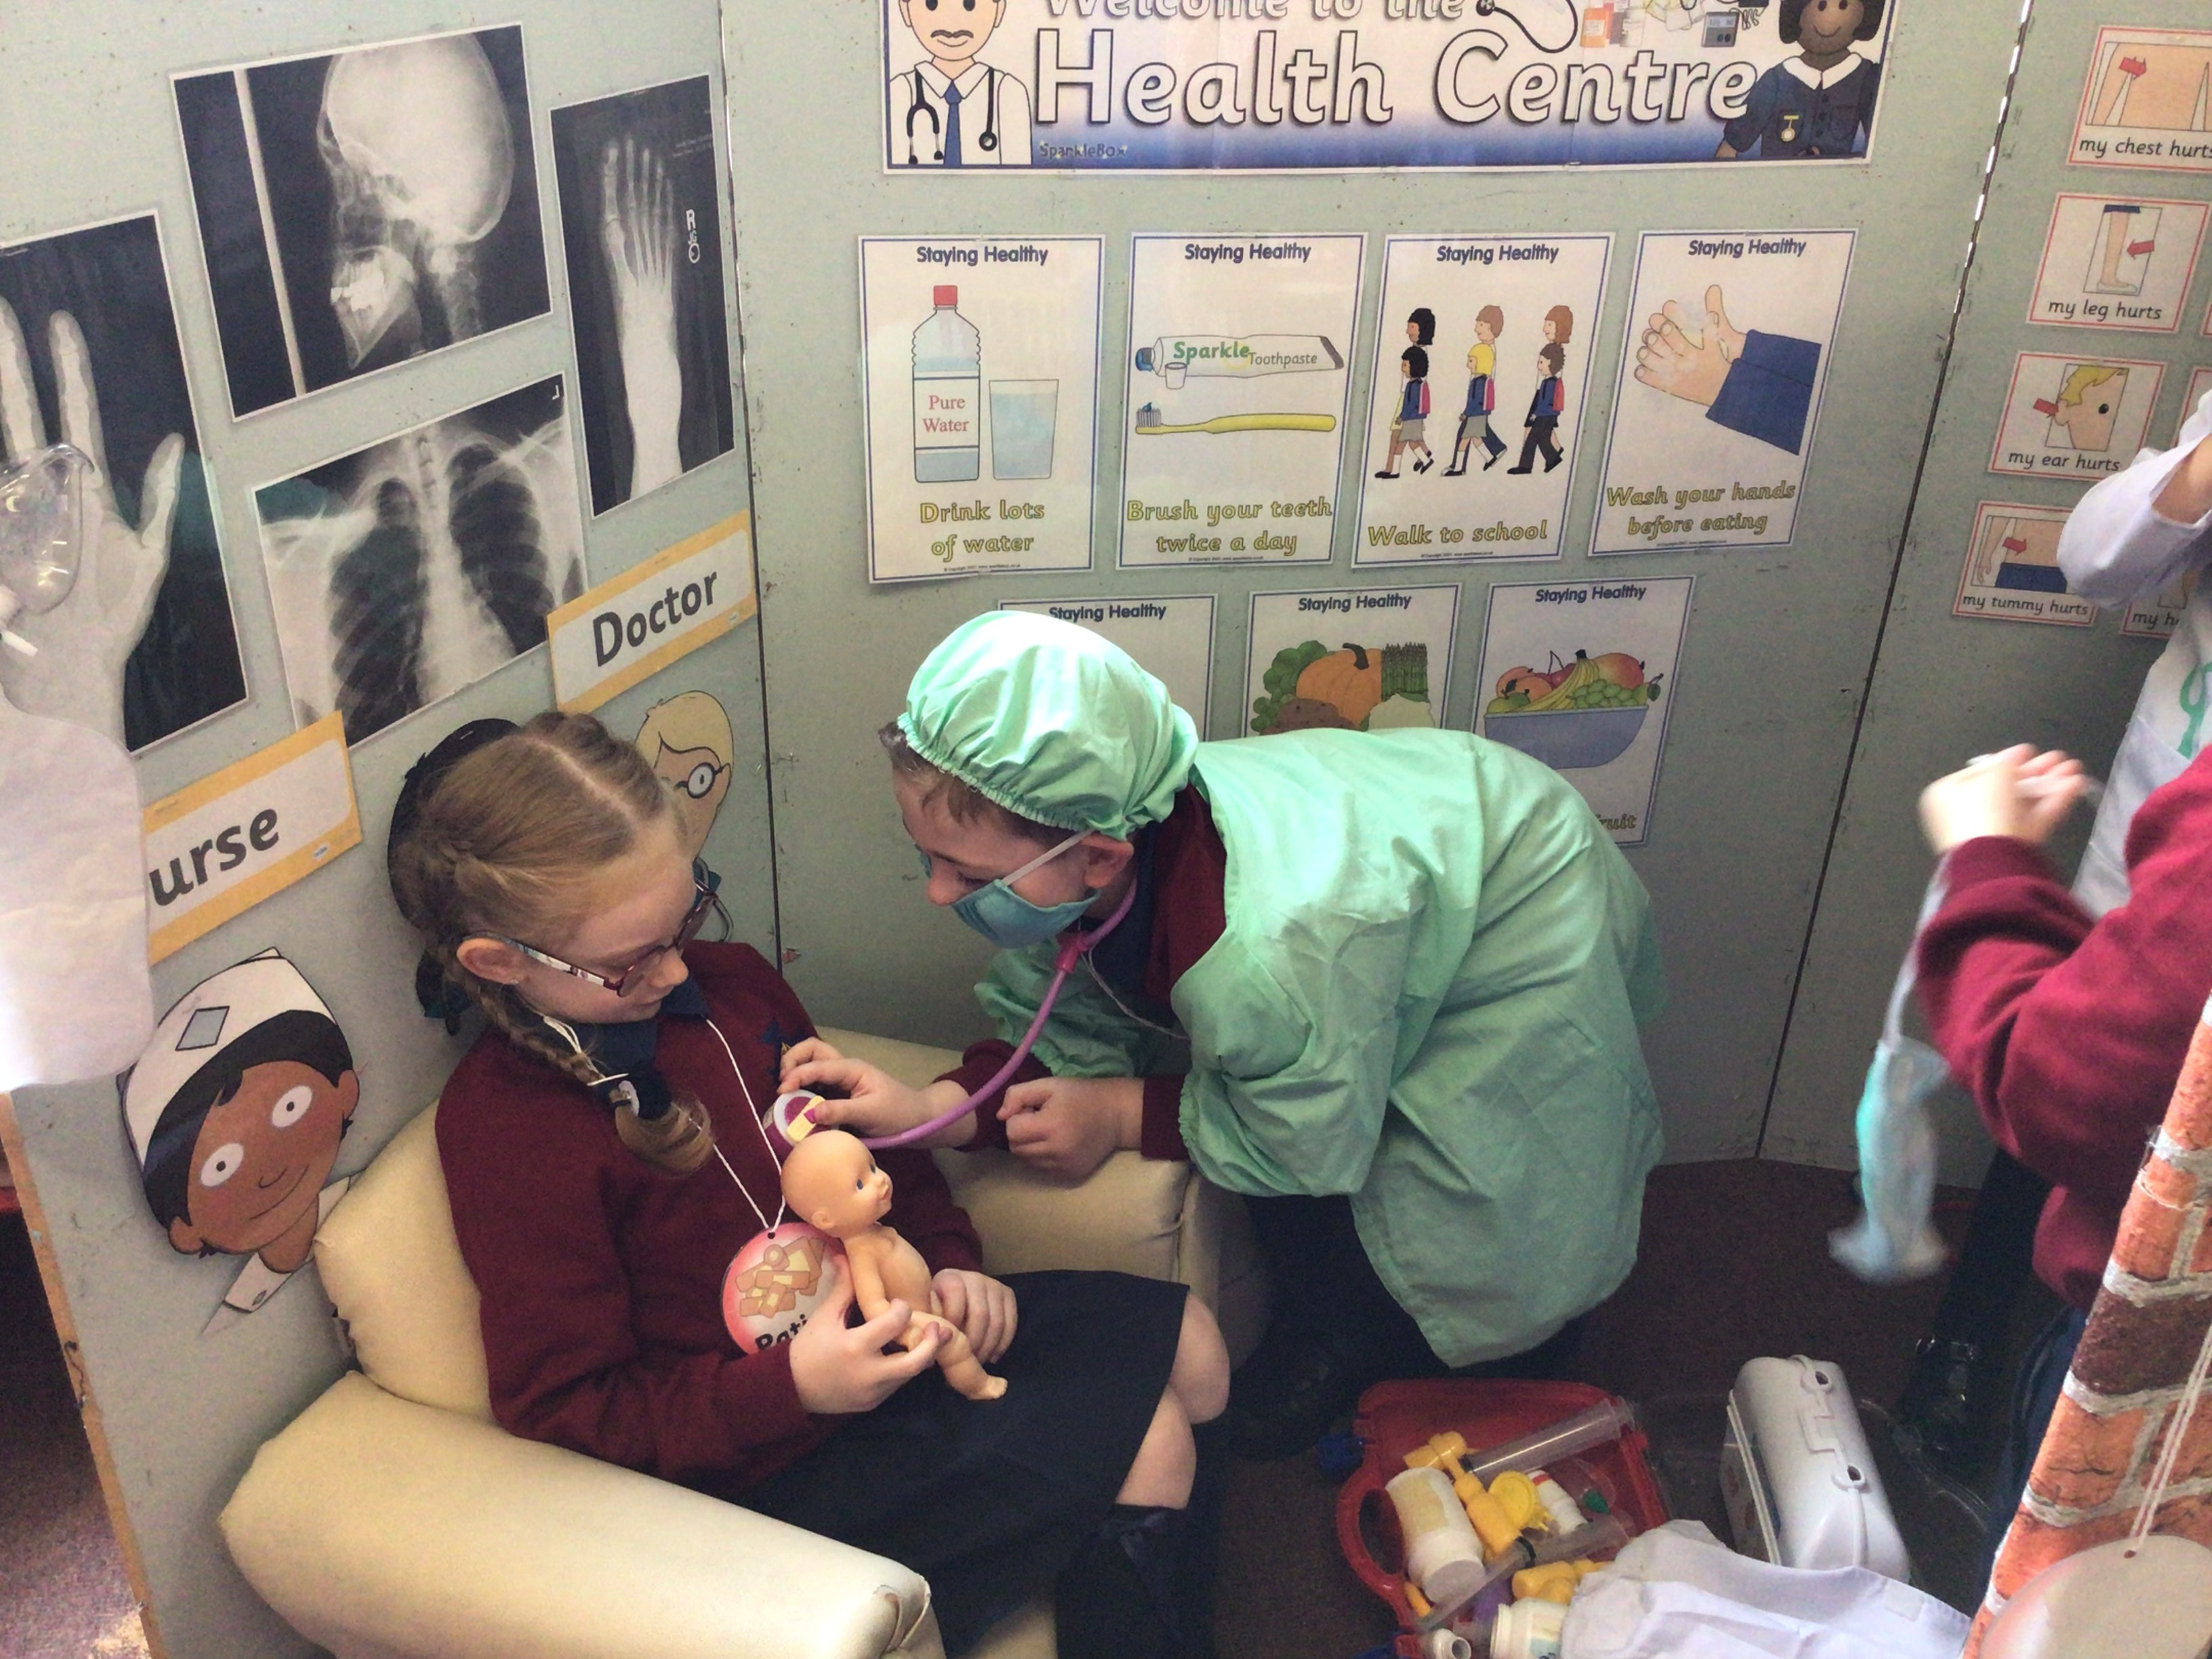
World Around Us

Slide 7



Hey, Hey Look at Me!
Twinkle Twinkle
Once Upon a Time
Let's Get Growing
Splish! Splash! Splosh!
Thematic based approach to WAU
Children are encouraged to investigate, explore, predict, make observations and ask questions linked to these topics
We bring children to the Half Moon lake to observe seasonal changes and we will visit Crawfordsburn beach as part of our Splish Splash Splosh theme in term 3
Notes:
Thematic based approach to WAU
Children are encouraged to investigate, explore, predict, make observations and ask questions linked to these topics
We bring children to the Half Moon lake to observe seasonal changes, and we will visit Crawfordsburn beach as part of our splish splash splosh theme in term 3

Slide 8
Grow in Love, P.E, The Arts, UICT
We use the religion scheme ‘Grow in Love’. Each week there is an activity to be completed at home, and we will share this via seesaw
P.E – we are currently following Core NI
The Arts - drama developed through role play area in the classroom, linked to literacy big books and stories
Music - linked to topic work, maths, seasons and holidays. We use the music scheme ‘Charanga’.
Art - children are exposed to different media such as clay, fabrics, junk materials. Art activities usually link in with holidays, seasons and big book stories.
ICT activities are integrated into all subjects through the use of iPads. Children will have access to our ICT suite to further develop their computer skills.
Notes:
We us the religion scheme Grow in Love. Each week there is an oral activity to be completed at home, and we will share this via seesaw
P.E – we are currently following Core NI. P.E is every Friday. Children should come to school in their P.E gear
The Arts - drama developed through role play area in the classroom, linked to literacy big books and stories
Music - linked to topic work, maths, seasons and holidays
Art - children are exposed to different media such as clay, fabrics, junk materials. Art activities usually link in with holidays, seasons and big book stories.
ICT activities are integrated into all subjects through the use of iPads. Children will have access to our ICT suite to further develop their computer skills.
If you have not signed up to seesaw yet, instructions and QR code are inside the cover of the homework books.

Slide 9
Thank You!

