Slide 1

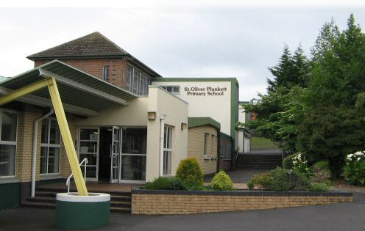
Year 2 Curriculum Meeting

Slide 2


School Times
8.45am to 2.00pm
School starts at 8.45am
Encourage your child to be independent, leave them at their line in the playground. Teachers begin teaching at 8.55am and are not available to come to the door for a message/chat.
External classroom doors will be locked at 8:55am therefore children arriving late will have to enter via the main office.
Breakfast club £2 per day from 8am to 8.45am
School Dinners - £2.60 per day
Collection at home time is from the outside playground door only for child protection reasons.
NO Dogs are permitted on the school grounds please
Chapel gate is now closed but other gates remain opened as normal, before and after school.
Notes:
School starts at 8.55am
Encourage your child to be independent and join their class line. Teachers begin teaching at 8.55am and are not available to come to the door for a message/chat.
External classroom doors will be locked at 8.55 so children arriving late will have to enter via the main office. If your child will be absent from school, please contact the school office that morning.
Breakfast club £2 per day from 8am to 8.45am
School Dinners - £2.60 per day. Please send in the money in a labelled envelope each Monday.
Collection at home time is from the outside playground. Children will be dismissed through the gate by their class teacher.
Please could we ask for your cooperation to ensure that no dogs are taken on to the school grounds at drop off and collection times.
Chapel gate is now closed but other gates remain opened as normal, before and after school.

Slide 3

Notes:
MR Sports After School Programmes
MR Sports have brought their after-school programmes to our school
They offer a different club each day alongside a wraparound service, ensuring there is an option for children and parents from 2–4 pm each day.
MR Sports Clubs:
2–3 pm for P1–P3 pupils
3–4 pm for P4–P7 pupils
(All clubs from 2–3 pm on Friday)
Ruby Roos Childcare:
This service involves Lego, arts and crafts, games, and sports each day:
2–3 pm for P1–P3 pupils
3–4 pm for P4–P7 pupils
Ruby Roos can also be added to any MR Sports club to provide a 2-hour after school option.
Example: Monday – 2–3 pm Football, then Ruby Roos 3–4 pm.
This service provides an affordable after school club and childcare option at £3 per hour, with payment accepted by card, childcare voucher, or tax-free childcare (up to 35% savings possible).

Slide 4
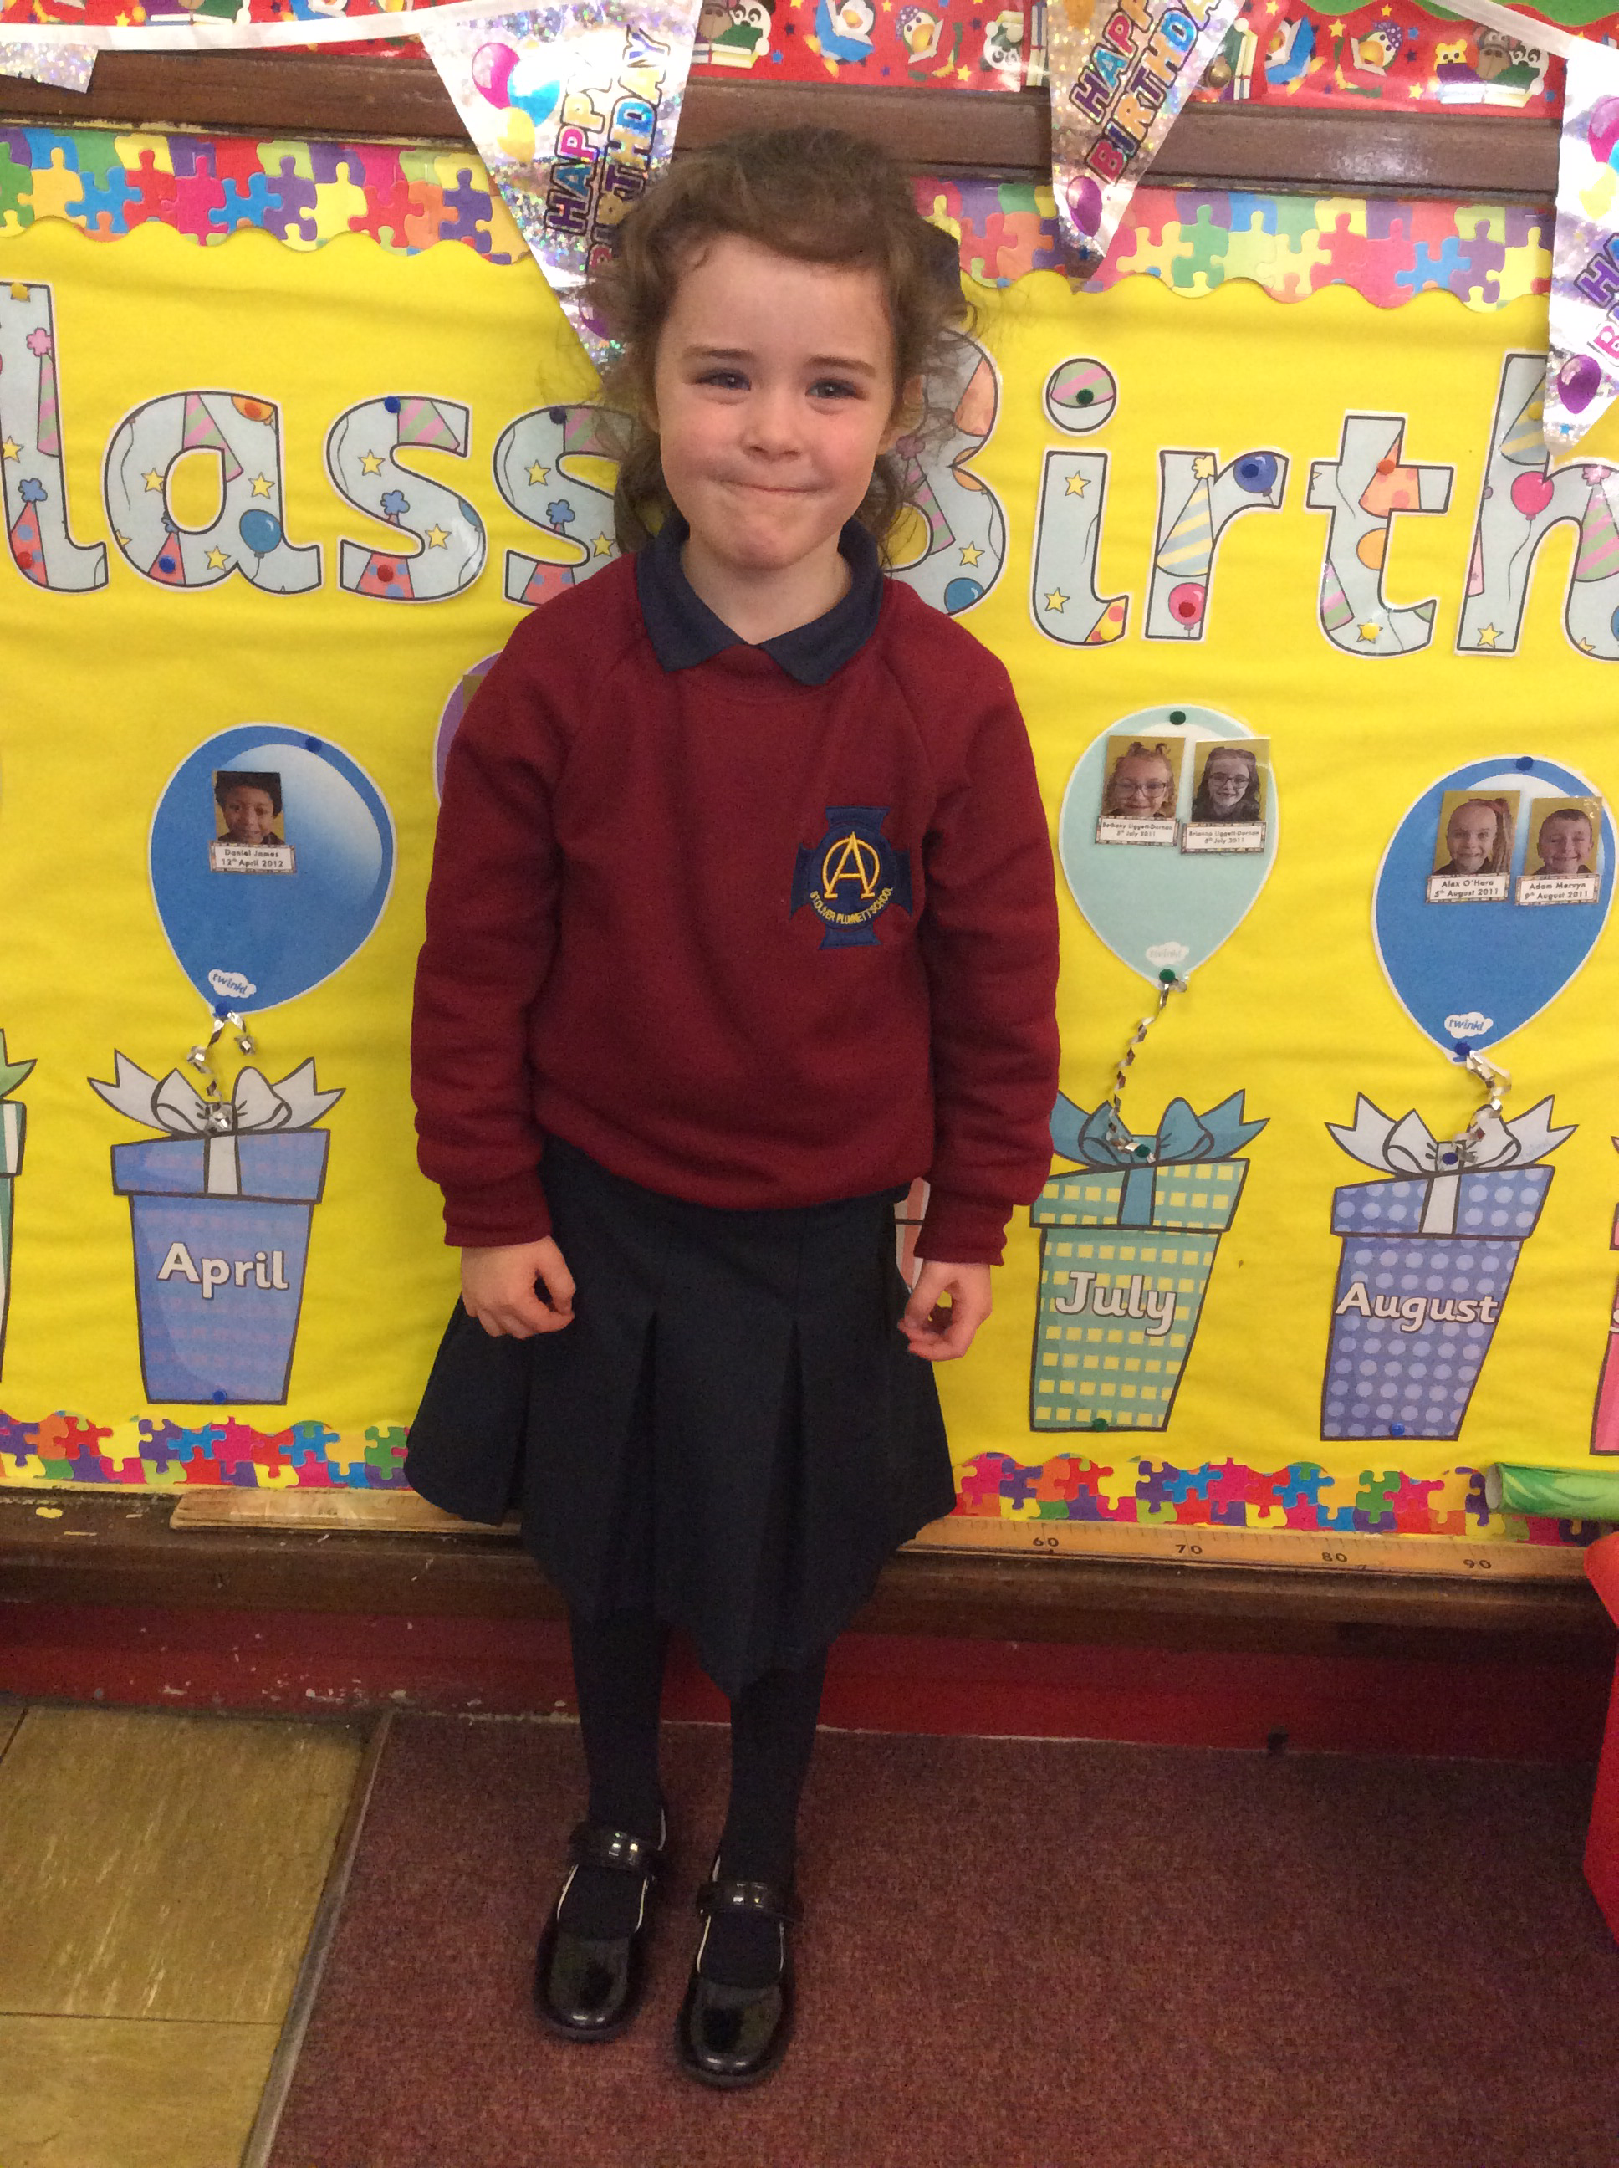
School Uniform
Clearly labelled
PE uniform
Uniform
All items labelled including coats, shoes, lunch boxes and break tubs
Please ensure jumpers are labelled as children take them off in class during the day when it is hot
No earrings
Black shoes
Coat to school every day
PE gear
Plain navy shorts or navy track bottoms
No football badges please
White t-shirt
Trainers, preferably with a Velcro
P.E uniform to be worn on P.E days and on days that your child is attending an afterschool sporting club.
Notes:
All items labelled including coats, shoes, lunch boxes and break tubs
Please ensure jumpers are labelled as children often take them off in class when they are too hot. We cannot be held responsible for missing jumpers which aren't labelled
No earrings or covered with a plaster
Black shoes
Coat to school every day
PE gear
Plain navy shorts or navy track bottoms
White t-shirt
Trainers, preferably with a Velcro fastening
P.E uniform should be worn on P.E days and on days that your child is attending an afterschool sporting club.

Slide 5

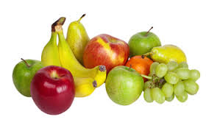
Healthy Break
fruit
plain sandwich
plain biscuit
Water or milk
*We are a NUT FREE SCHOOL*
Healthy Eating Policy
Break will be limited to 1 item of either fruit or raw veg, a plain sandwich - no jam, Nutella or sugary spreads or a plain rich tea or digestive biscuit
Milk or water to drink
Notes:
Healthy Eating Policy
Break will be limited to 1 item of either fruit or raw veg, a plain sandwich - no jam, Nutella or sugary spreads, or a plain rich tea or digestive biscuit. Milk or water to drink

Slide 6
Homework

Slide 7

Shared reading
Guided Reading
Topic related activity
Maths reinforcement
Linguistic Phonics practice
Handwriting practice
Useful websites or apps
Homework is set to reinforce work completed in school
Guided reading is the ORT/Kipper books which have been taught the week previously in school
Shared reads are for fun and enjoyment
It is important to practise word building activities using the letter squares sent home
Encourage your child to practise handwriting in their homework book - use one page per week for that week's practising
Homework should take no more that 15 - 20 minutes
Notes:
Homework is set to reinforce work completed in school
Guided reading is the ORT/Kipper books which have been taught the week previously in school
Shared reads are for fun and enjoyment
It is important to practise word building activities using the letter squares sent home
Encourage your child to practise handwriting in their homework book - use one page per week.
Homework should take no more that 15 - 20 minutes

Slide 8
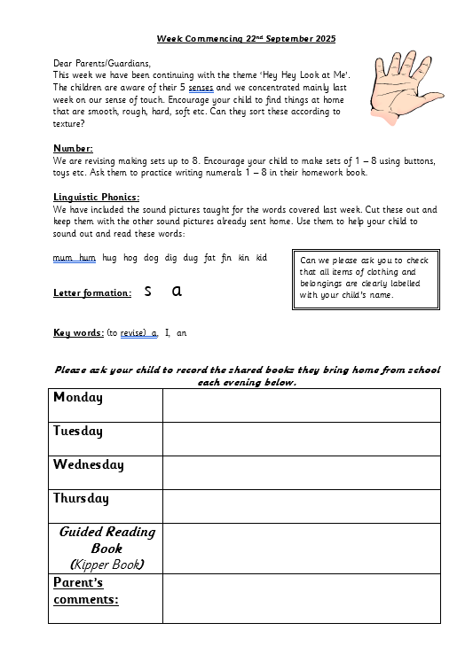
This is a weekly homework sheet
Each night get your child to record the book that they read (shared books)
Guided reading is the kipper book which your child will bring home in their reading folder
Use the homework book, which is lined to practise writing words, sentences or number activities but we will ask you to limit this to one page per week
Notes:
This is a weekly homework sheet
Each night encourage your child to record the books that they havec read, You can note any other activities completed e.g. Practical maths, mental counting etc in the Parent’s Comment section.
Guided reading is the kipper book which your child will bring home
Use the homework book, which is lined to practise writing words, sentences or number activities but we will ask you to limit this to 1 page per week.

Slide 9
Literacy

Slide 10

Reading
Oxford Reading Tree
Shared reading daily
Learning sight words
Children read daily in class. We use ORT as our main scheme. Children work on these book in class and they are sent home the following week, so the text is always familiar to the children.
ORT book must be taken very good care of, always kept inside their folder - there is a £5 replacement fee for damaged/lost books.
Shared reading books are for fun so don't worry if your child cannot read these independently. They are for enjoying with an adult at home.
It is important to practise frequency/speed words with your child. Children need to know how to recognise some words on sight as they don't have all the sounds for sounding out unknown words. Use the speed-reading card in their reading folder, practise one set each week or until your child can read them fluently.
Notes:
Children read daily in class. We use ORT as our main scheme. Children work on these book in class and are sent home the following week, so the text is always familiar to the children
ORT book must be taken very good care of, always kept inside their folder - there is a £5 replacement fee for damaged/lost books
Shared reading books which the children take home are for fun so don't worry if your child can’t read these independently. They are for enjoying with an adult at home.
It is important to practise frequency words with your child. Children need to know how to recognize some words on sight as they don't have all the sounds for sounding out unknown words. Use the speed-reading card in their reading folder, practise one set each week or until they are fluent.
Community Library (Suffolk). Free to join and borrow books

Slide 11
Phonics
Start with initial letter sounds and names
Move through double letter sounds and blends
Phonics is practised daily in class
Keywords (or spellings) are based upon the sounds we are working on in class
The children have been learning cvc words and will move on to ccvc and cvcc words, multisyllabic words and frequency words
Keywords are worked on in class before being sent home.
It is important to practise these daily as children are tested on these each Friday in class. They will also write a dictated sentence which includes sounds worked on in class.
Notes:
Phonics are practised daily in class
Keywords (or spellings) are based upon the sounds we are working on in class so currently children are learning cvc and vc words as well as frequency words
Keywords are worked on in class previously before sent home
Important to practise these daily and children are tested on these on Friday in class. They will also write a dictated sentence which includes sounds worked on in class.

Slide 12

Writing
Nelson handwriting scheme
Lower case
Uppercase
In Year 2 we continue with Nelson handwriting scheme
We are currently working on lower case formation
After Christmas we move on to upper case letters
Encourage your child to form letters correctly, in the right direction, with tall letters touching the top line and letters with tails to sit on the line with the tail under the line
There is a handwriting guide inside the homework books. Please show your child the handwriting video sent home on seesaw each week.
Children will move onto lined books after Christmas
Notes:
In yr2 We continue with Nelson handwriting scheme
Currently working on lower case formation.
After Christmas we move on to upper case letters.
Encourage your child to form letters correctly, in the right direction, with tall letters touching the top line and letters with tails to sit on the line with the tail under the line.
There is a handwriting guide inside the homework books
Children will move onto lined books after Christmas.
We have some Nelson books here which you are welcome to look at the end.

