Slide 1

St Oliver Plunkett Primary School
Year 1 Open Day
2016/2017
St Oliver Plunkett Primary School
Year 1 Curriculum meeting

Slide 2
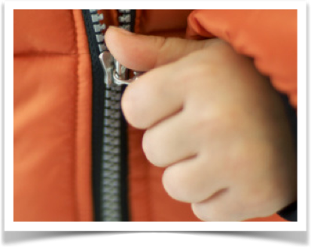
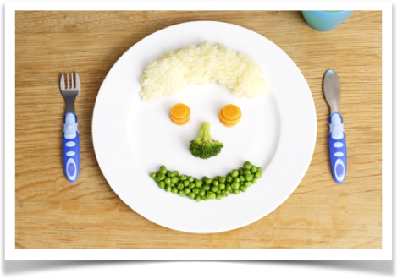
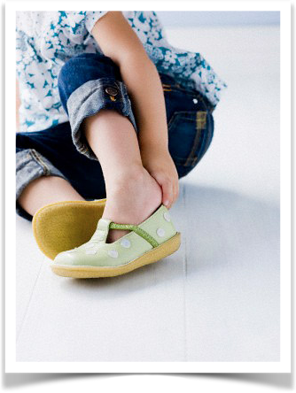
Independence is key!

Slide 3


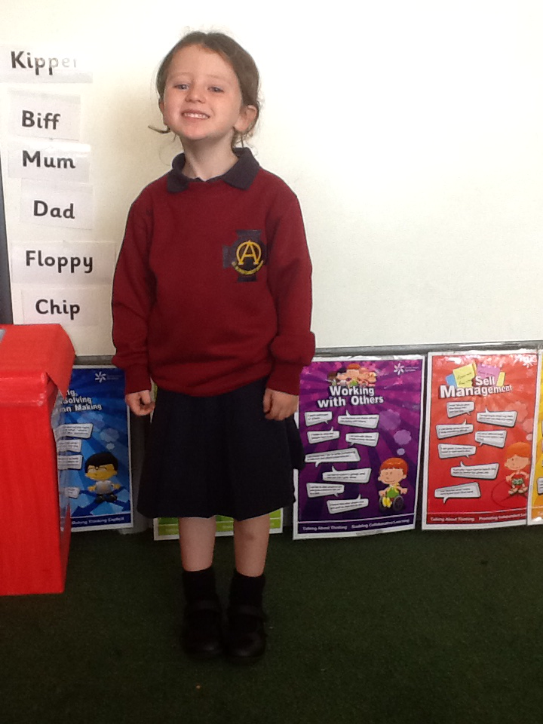
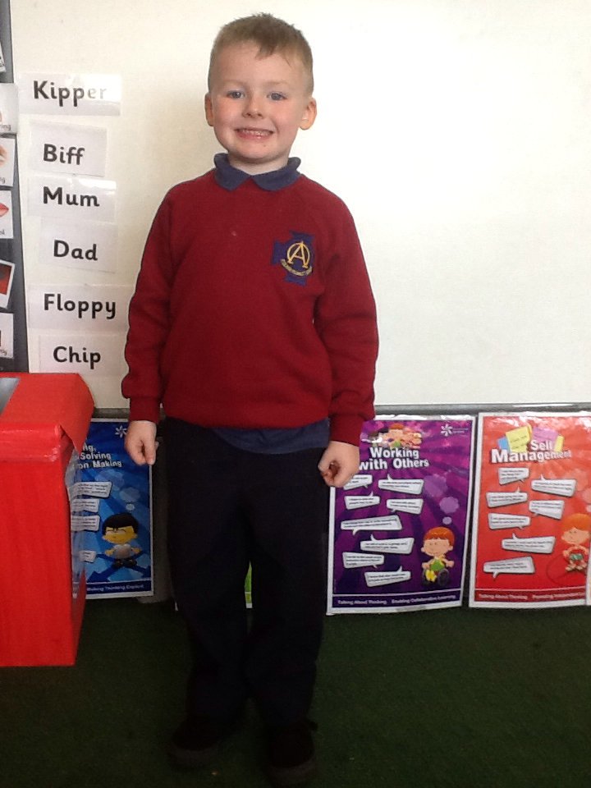
School uniform
PLEASE NOTE: P.E. uniform to be worn on P.E. and Outdoor Play days. Children may also wear P.E. uniform if they are attending an afterschool sporting club.

Slide 4




Class begins at 8.45am. After 8.50am children should enter by the main office door and a member of staff will bring your child to class.
School finishes at 2pm. Please pick up promptly at playground. Please wait for the children to be dismissed by class teacher.
Due to safeguarding reasons parents are not permitted to enter the school without an appointment.
Notes:
School begins at 8.55am
Punctuality is an important trait to foster in your child. The playground door will be locked at 8.55. In year one we would ask that children are in no earlier than 845am
Up until sept 30th children will finish at 12.30 after the 30th they will finish at 2pm
Please collect from the playground door.
Also an adult has to collect.

Slide 5

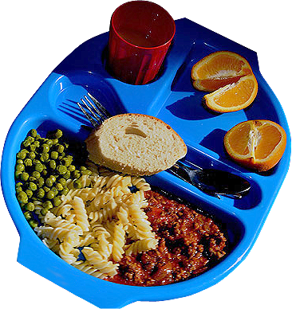

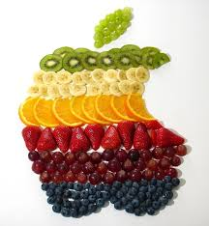



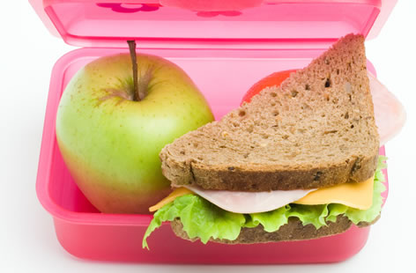
Save our smiles!
Healthy snack for break
School dinner - £2.60 per day
Or
Healthy packed lunch- sandwich or piece of fruit
1 item only
Please note: We are a nut and egg aware school!!
Milk- look out for notifications on SeeSaw/email

Slide 6

Please send in the correct money in a labelled envelope.

Slide 7

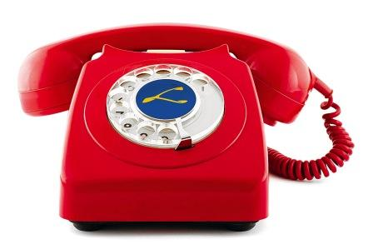


2 contact numbers in case of illness or another emergency.
Does your child have an allergy or a pre- existing condition? Please let us know ASAP.
Please email the school to let us know if your child is going to be absent. Put your class teacher in the subject box.

Slide 8

Afterschools Program

Slide 9
Please remember:
MR Sports now co-ordinate all afterschool provision.
This runs from Monday-Thursday 2-4pm Friday 2-3pm (£3 per hour)
www.mr-sports.co.uk
ALSO:
*NO dogs are permitted on the school grounds.
*Chapel gate is now closed but other gates remain opened as normal, before and after school.

Slide 10

Literacy

Slide 11

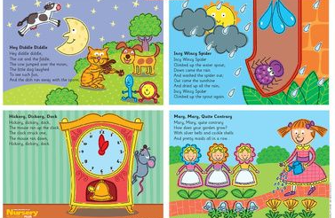

Reading
ORT Talk About Cards
ORT Guided Reading Books
Nursery Rhymes
Class/ School Library
Community Library (Suffolk)
Bed Time Reading/ Shared Reading

Slide 12

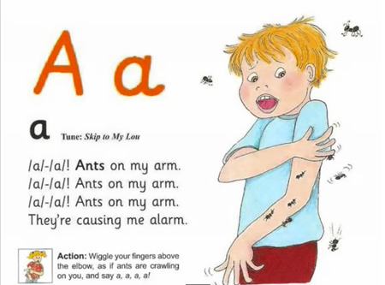
Linguistic Phonics
Letter name
Letter sound
Item beginning with sound
s, a, t, p, i, n, m, o, c, d

Slide 13





Nelson Handwriting Scheme
Introduce 1-2 letters a week
Homework handwriting page use for reference
Children practise handwriting through various games e.g. sand, whiteboards, blackboards

Slide 14

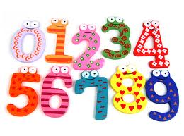
Numeracy

Slide 15

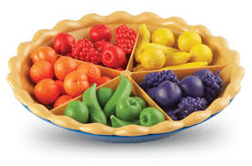
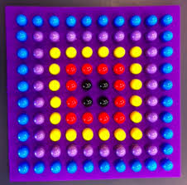



Sorting
Pattern making
Shape recognition
Number- recognition, counting, making sets

Slide 16

Play Based Learning

Slide 17
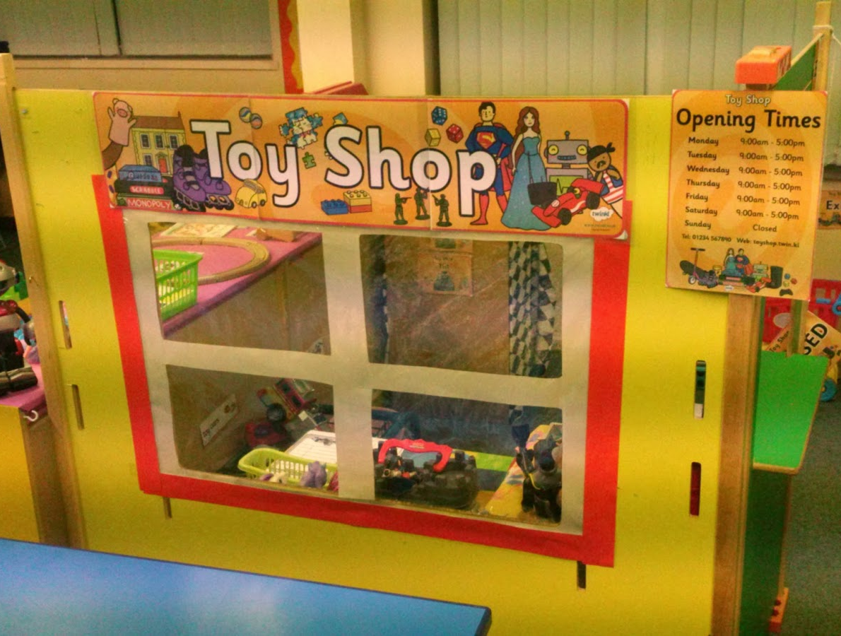
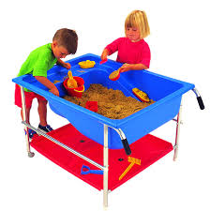
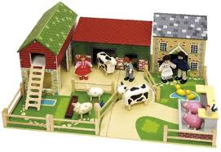

Independent Play- Child initiated
Role Play
Creative Play- sand, water, art
Small World Play
Construction
Outdoor Play

Slide 18


Home school link
Homework
Seesaw
Email

Slide 19


Happy children learn!

