Slide 1

Saint Oliver Plunkett P.S.
Year 5 Curriculum Meeting

Slide 2
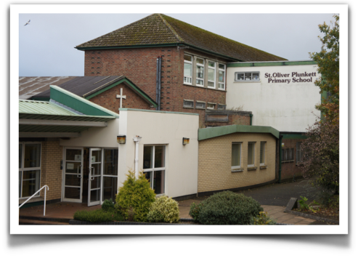
Year 5
Curriculum Meeting

Slide 3


Our Day
Class starts 8:45 am
Break 10:30 -10:45 am
Lunch 12:25 - 1:00 pm
Home-time - 2:45 pm
(2:00pm Friday Only)
Notes:
Children should not go to classrooms before 8:30am. If they arrive into school early they should go straight to Breakfast club which runs everyday from 8am-8.35am. The cost is £1 per day and is paid directly to the assistants supervising.
Any child who needs to leave school early should be signed out at reception before being collected from class.

Slide 4

If you need to speak to a teacher, please contact the school office to arrange an appointment.
The phone number is 0289080677.

Slide 5


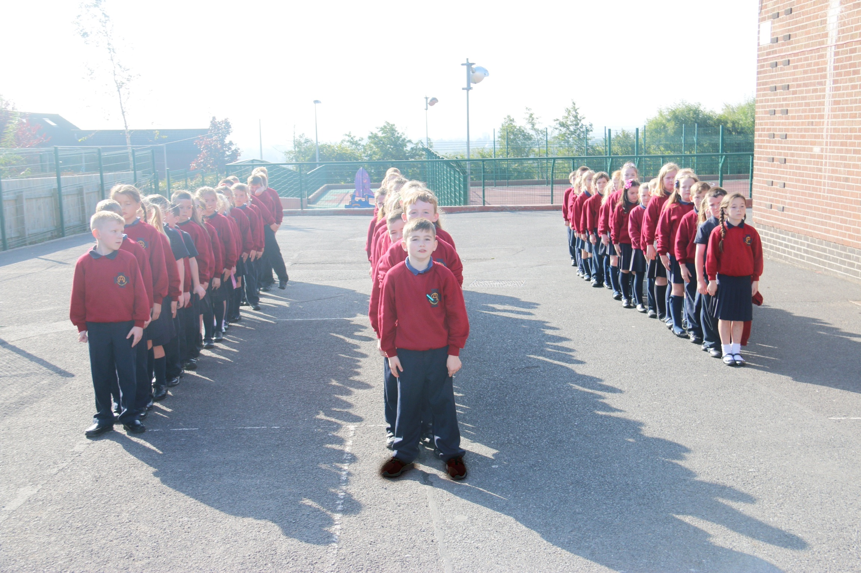
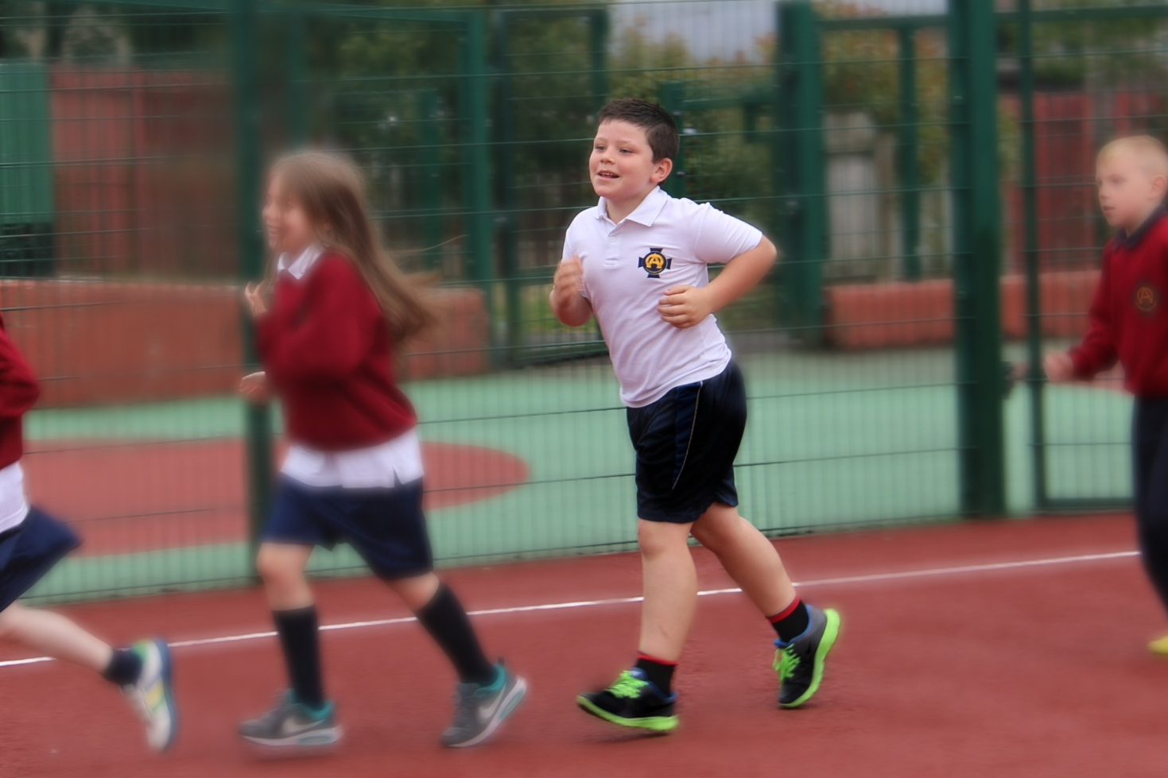

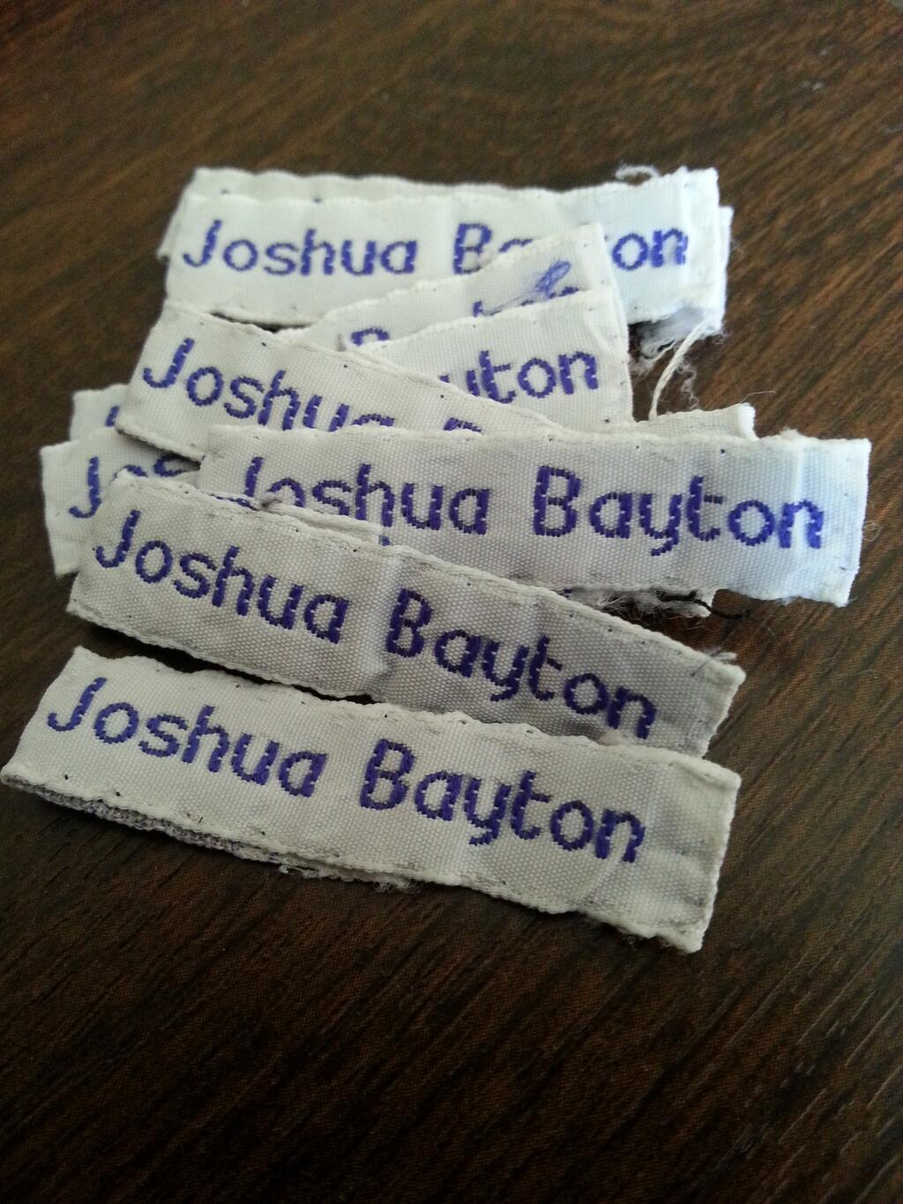
School Uniform
P.E Uniform
Labelled

Slide 6


Milk Money is paid termly.
Dinner Money £2.60 daily.

Slide 7
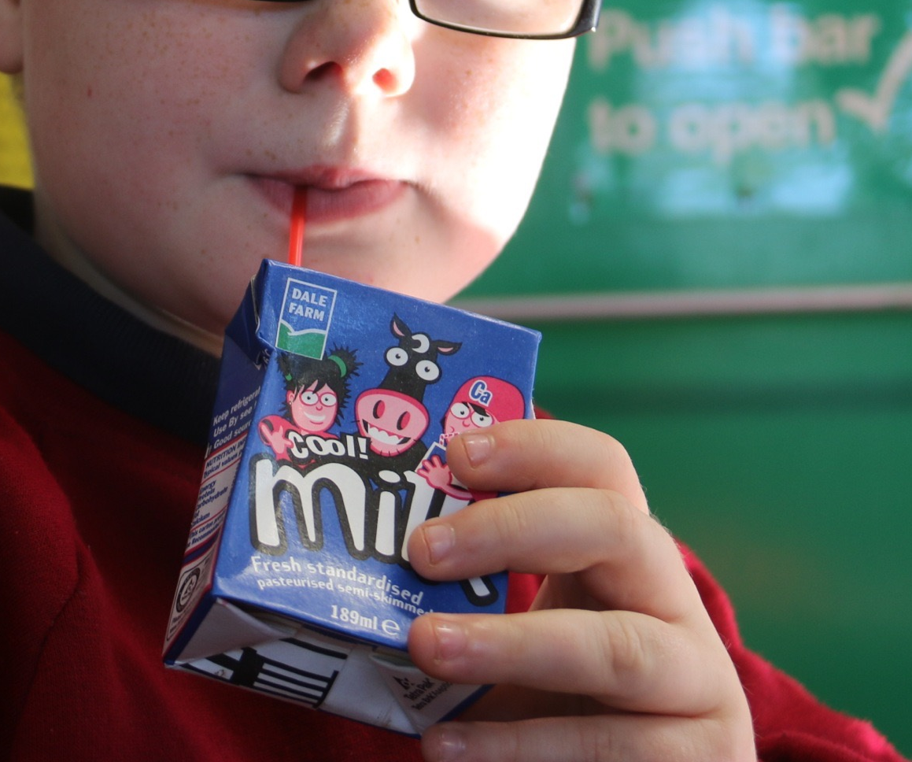
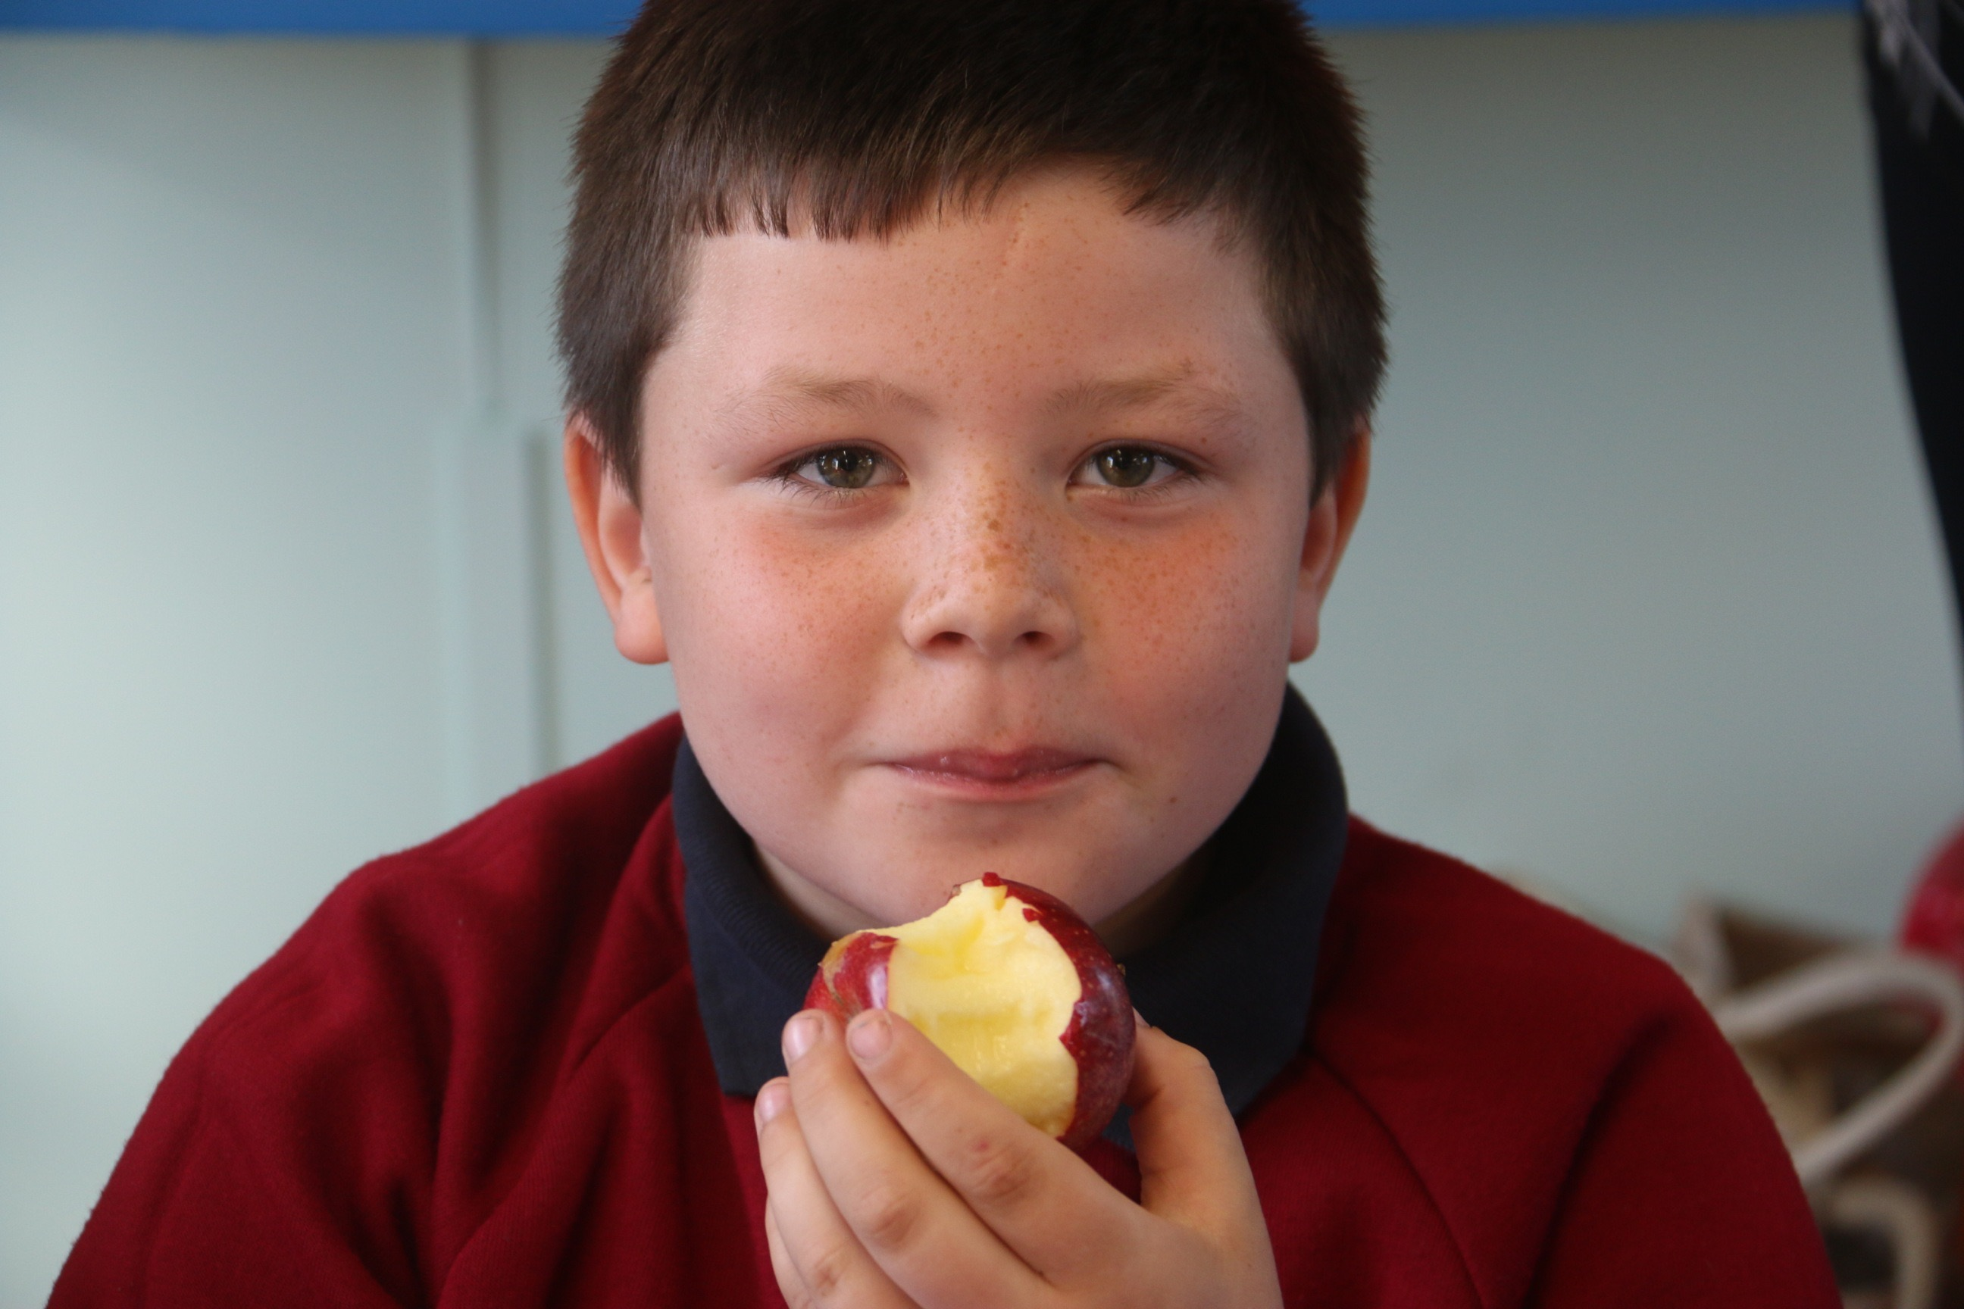

Healthy Break
Notes:
A healthy break consists of one piece of fruit, a small sandwich or a plain biscuit.
We would ask that children only have one thing to eat for snack.
Snacks can be purchased from the Tuck Shop which is open daily until 9am

Slide 8

Homework
Please Sign

Slide 9



Literacy​
Reading Nightly​
Spellings Nightly​
Spelling Practice Nightly​
Comprehension​ (Monday)
Grammar Focus​ (Wednesday)
Notes:
Table and Spelling practice book- nighty revision

Slide 10
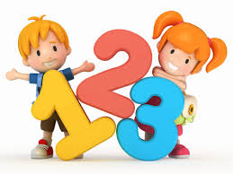


Numeracy
Times Tables Practice Nightly​
Number Focus​ (Tuesday)
Topic Focus (Thursday)
Notes:
Table and Spelling practice book- nighty revision

Slide 11




Curricular Areas
Literacy
Numeracy
World Around Us
The Arts
PDMU/Mental Wellbeing
P.E
R.E

Slide 12




Language and Literacy
​
Talking and Listening​
Reading​
Writing

Slide 13

Reading​

Slide 14


Accelerated Reading​
Pupils are encouraged to participate in Accelerated Reading every day, at school and at home.
We encourage all pupils to join the community library and sign up to the Libby App.

Slide 15



Shared Reading

Slide 16




Guided Reading

Slide 17

Writing

Slide 18

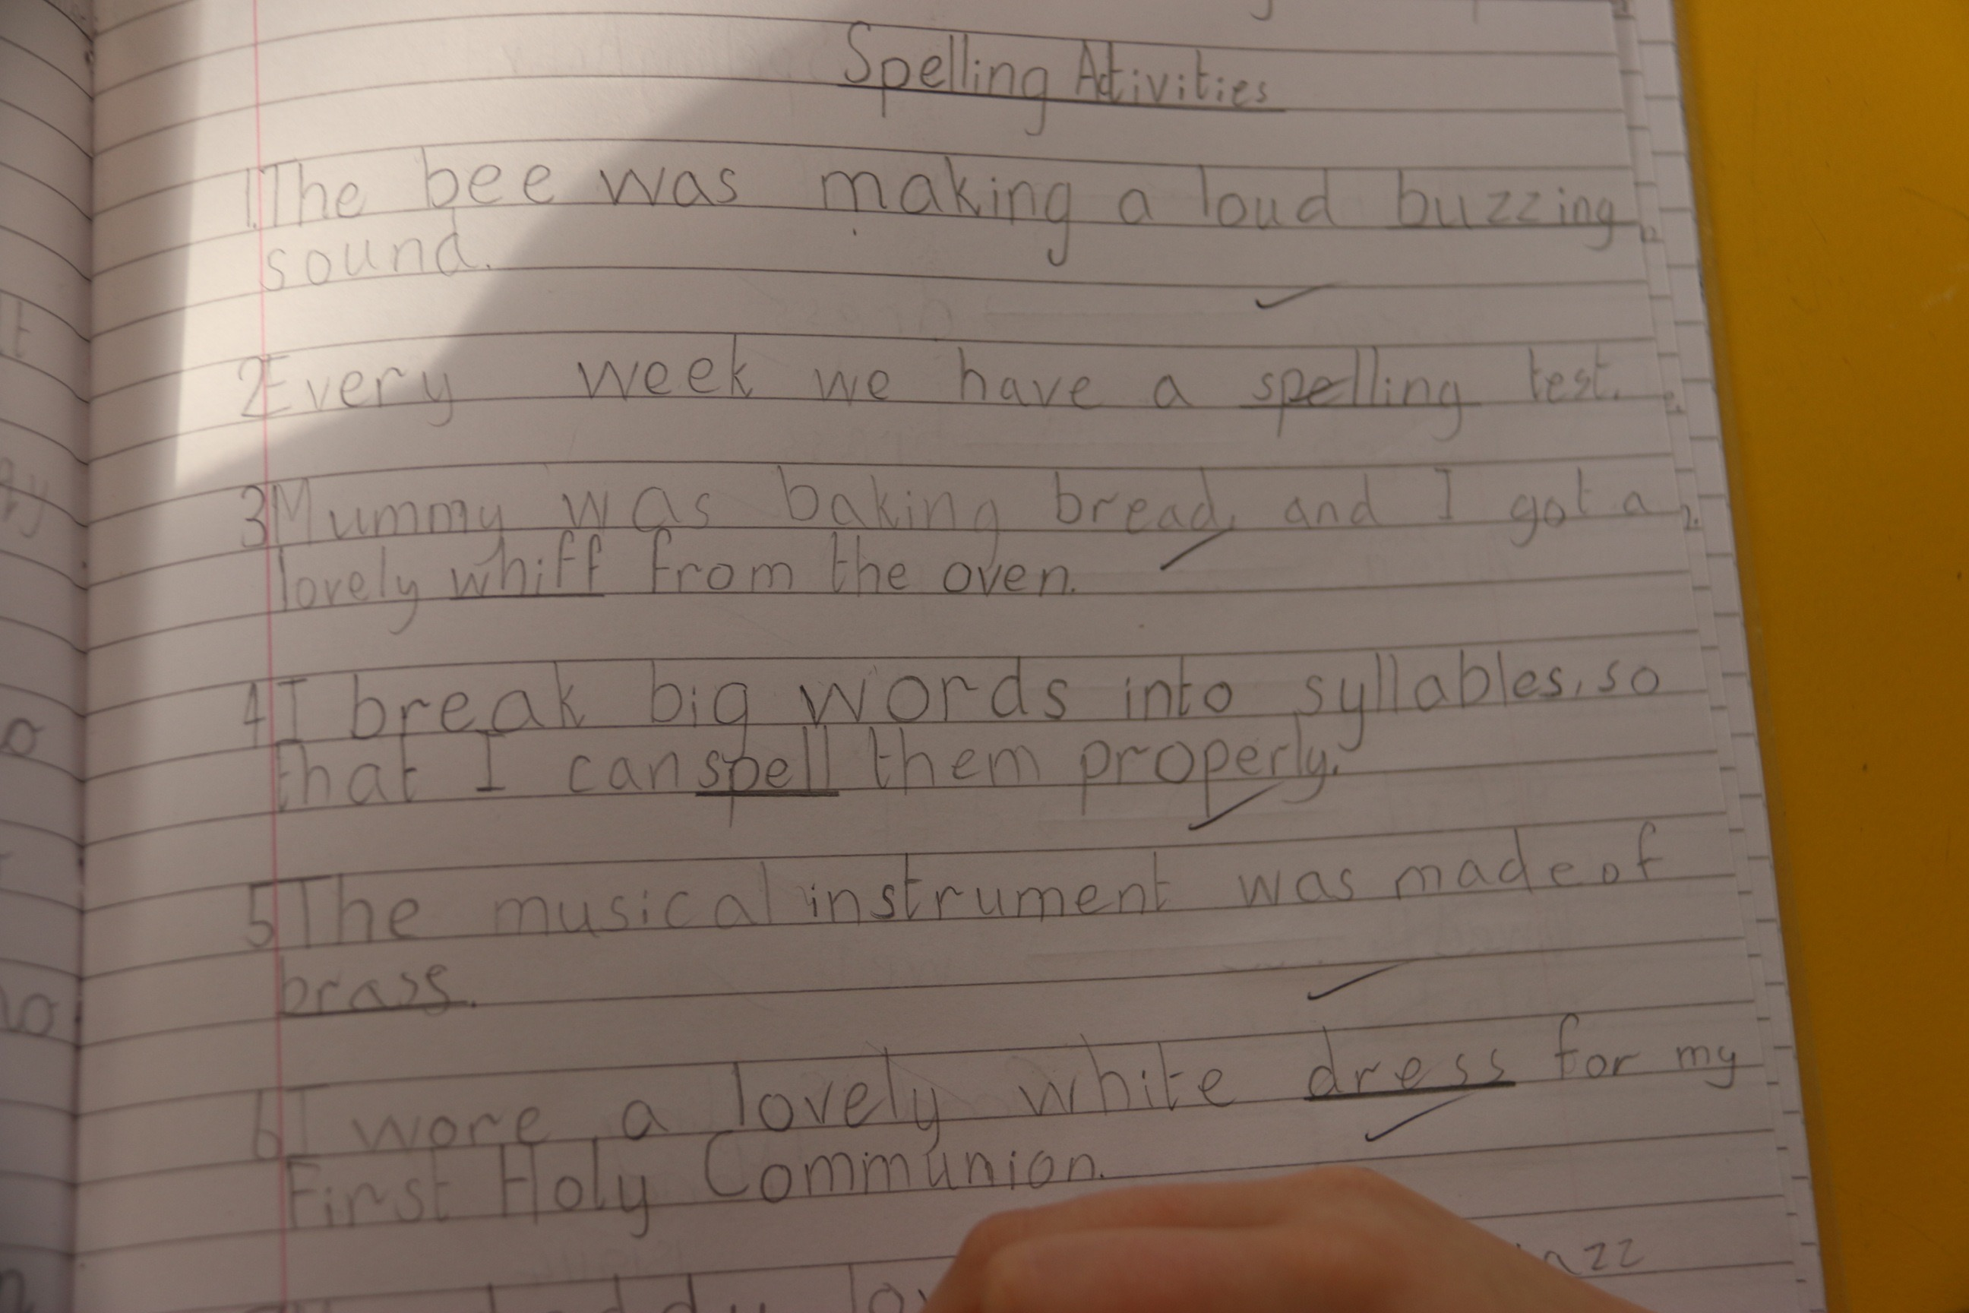
Every week, we cover grammar, spelling and develop writing skills.
Throughout the year we cover a wide range of writing genres:
Narrative Explanation
Recount Poetry
Persuasive

Slide 19
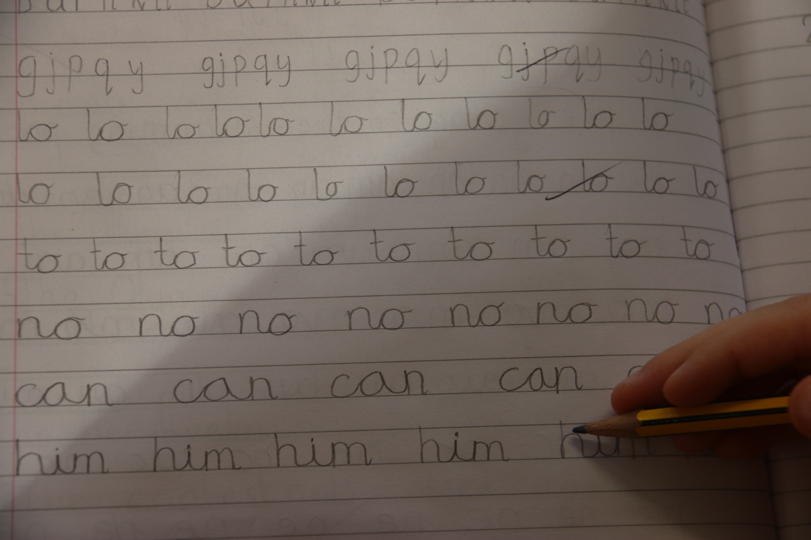
We practise cursive script daily.

Slide 20

Grammar
Nouns, verbs, adjectives
Adverbs
Punctuation
Direct Speech
Comparatives and Superlatives
Plurals

Slide 21

Numeracy

Slide 22


Numeracy in Year 5
Number
Measures
Shape and Space
Data Handling
Mental Maths
Problem Solving

Slide 23

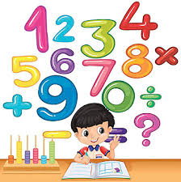
Mental Maths
Number bonds
Mental addition and subtraction
Multiplication tables
Counting in multiples
Doubling
Mental strategies

Slide 24
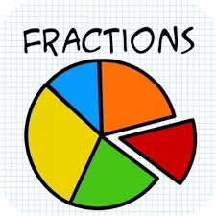

Number
Revision of addition and subtraction
Multiplication and division x2 - x10 tables.
Problem solving
Place value to 9999
Rounding to the nearest 10, 100 and 1000
Fractions
Money
Freckle (Online numeracy activities)

Slide 25
Measures
Length - kilometres, metres and centimetres
Time – analogue, digital, calendar
Area and Perimeter - Counting cm and 1/2 cm squares
Capacity and Volume - standard and non-standard measures
Weight - Grams and Kilograms

Slide 26


Shape and Space
2D and 3D shape
Symmetry
Tessellations
Angles
Clockwise and anti-clockwise
Compass points and direction
Grid references

Slide 27


Handling Data
Temperature - climate and seasons.
Reading a thermometer
Bar graphs, tally charts and Carroll diagrams

Slide 28

Problem Solving
Using RUCSAC
Group based
Real life investigations
Skills based
Alternative strategies to solve problems
Sharing and evaluating methods

Slide 29

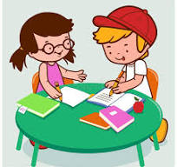
Assessment
Weekly assessments- Spelling, Times Tables Mental Maths, AR
Six Weekly Assessments- Class tests, STAR Reading, STAR Maths, NGRT (Termly)
PTE and PTM- End of May

Slide 30

Key Points
Discuss mental strategies/methods with your child.
Mathematical vocabulary/concepts can be covered at home - time, shape, measure etc.
Please ensure homework is checked and signed nightly.

Slide 31


World Around Us
Geography, History, Science and Technology.
Strand 1: Interdependence
Strand 2: Movement and Energy
Strand 3: Place
Strand 4: Change Over Time

Slide 32



Topics
Term 1: The Vikings
Term 2: Up, Up and Away
Term 3: Raiders of the Lost Tomb
(Ancient Egypt)
Notes:
Cover all strands of WAU- technology, science, movement and energy and change over time

Slide 33
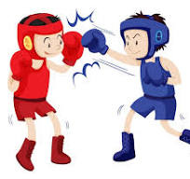





Physical Education
Coaching (Boxing)
Swimming (Term 2)
Core NI activities
Athletics, small sided games, dance etc.

Slide 34


Religious Education
Grow in Love Programme
Daily Prayer
Mass
Saint / Feast Days
Charity work/community links

Slide 35



P.D.M.U / Wellbeing
Daily Mile
Daily meditation and breathing exercises.
Weekly CORE NI wellbeing lessons.

Slide 36

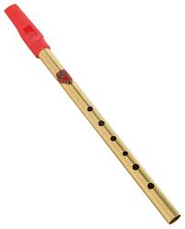

The Arts
Art and Design
  Time to Shine programme
Music
Charanga programme
Tin Whistle
Drama
Role play
Hot Seating
Theatre Performances

Slide 37

General Points
During school hours, please use the main Glen Road gate.
Please ensure any other gates used are closed behind you in the interest of health and safety.

Slide 38

General Points
Please remember that dogs are not allowed in the school grounds.

Slide 39

General Points
We operate a strict NO mobile phone policy at all times.
Should you need to contact your child, please do so via the main office.
If there are exceptional circumstances as to why your child needs to bring a mobile phone to school, it MUST be switched off before entering the school grounds and left at reception BEFORE arriving to the playground or classroom.
Mobile phones can be collected at the end of the school day and MUST remain OFF until outside the school grounds.

Slide 40

After Schools
Pupils attending sports after schools should wear P.E gear to school.

Slide 41






Slide 42

Individual Parent/Teacher meetings will take place week beginning 10th November.
In accordance with school policy please make an appointment through the office if you wish to speak to the class teacher.

Slide 43
We hope your child has an enjoyable learning experience in Year 5.
Year 5 Teachers.

