Slide 1
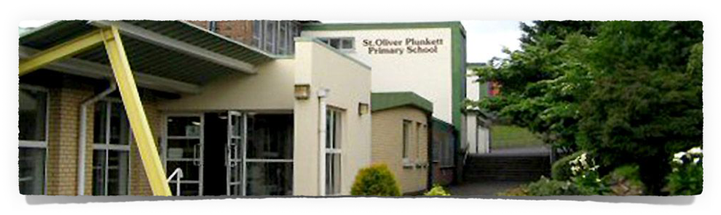
Year 3 Curriculum Meeting
2025/26

Slide 2
Information Included
Uniforms - school and PE
Attendance /Punctuality
Overview of curriculum in Year 3
Homework
Dates to note

Slide 3
Class starts 8:45am
Break 10:10 - 10:25am
Lunch 12:25-1:00pm
Home time 2pm
After Schools –
2pm – 3pm Activity
3pm – 4pm Ruby Roos (3pm on Friday)
(£3 per hour. MR Sports Online Booking).

Slide 4
Uniforms
Compliments on sending children off to a new year in full uniform- Thank you!
All jumpers and coats to be labelled please.
PE uniform on PE day (Wednesday)
PE uniform if attending after schools sport.
Teachers will inform you via Seesaw if the day changes.
No jewellery to be worn for health and safety reasons (If wearing earrings, studs only, please remove on PE day).

Slide 5

Attendance
Attend every day even if the child has slept in, or they have an appointment.
School places a huge importance on good attendance with rewards in place for each class monthly.
If you need to speak with a teacher, please contact the office.
Please let the class teacher know in advance if your child has an appointment during school hours.
Absent notes are going to be sent home. Please return to school so that the register can be updated.

Slide 6

Snack and Dinner
Water and milk only at breaktime.
Fruit, small vegetables, small sandwich, pancake, muffin, plain biscuit.
WE ARE A NUT FREE school and EGG AWARE school.
Dinners £2.60 a day/ £13.00 per week. Please send in money on Monday with the correct amount and days for dinner marked clearly in an envelope.

Slide 7
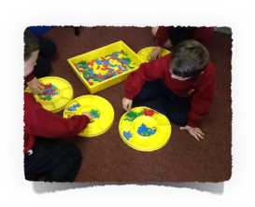
Overview of curriculum:
Numeracy
Number work
Mental Maths - Daily
Measure
Data handling
Shape and Space
Activity Based Learning / Outdoor Play / Big Play- children can explore mathematical concepts through play
Use of technology to embed concepts.

Slide 8

Literacy
Reading - aim to get children to read with fluency, understanding and most importantly, enjoyment.
Guided reading – Fiction and Nonfiction texts
Class/ School Library
Community Library (Suffolk)
Handwriting - whole school focus - daily practice
Developing Comprehension skills through use of textbooks.
Grammar and punctuation
Talking and listening - cross curricular
Use of technology to enhance each learning area within Literacy.

Slide 9

World Around Us
Incorporate Science, History and Geography
Topic this year are Home Sweet Home, On an Adventure and Weather Watchers
STEM - we will also be taking part in STEM based activities and experiments. STEM stands for Science, Technology, Engineering and Mathematics.

Slide 10
The Arts
The Arts include Music, Art and Drama.
Year 3 children have the opportunity to participate in Charanga music scheme.
Art – We are using ‘Art Time Let’s Shine’ programme
Drama – incorporated throughout the curriculum.

Slide 11

PE / Wellbeing
PE takes place every Wednesday – Games Term 1. Children should wear their PE uniform to school on PE day.
Core NI programme – meditation, PE lessons, brain breaks
Daily Mile
Breathing exercises
Mindfulness
Nurture in 5 / Yoga
Outdoor / Big play

Slide 12

Homework
2 x Numeracy homeworks Monday and Wednesday
2 x Literacy homeworks Tuesday and Thursday
Daily Phonics and High Frequency Words
Guided reading book - Oxford Reading Tree (Fiction) & All Aboard (Non-Fiction)
Spelling Challenge books sent home on a Monday to be signed and complete corrections.
Library Book – Weekly
Parental help - encourage as much independence as possible however all homework should be checked and signed by an adult.
Prayers will be sent home for First Confession to practice as we learn them in school.

Slide 13

See – Saw / Email
Please login to Seesaw to keep up to date with information from your class teachers.
Whole school notes will go out via email. If your email address changes, please let the office know.

Slide 14

Dates to note
Service of Enrolment – Wednesday 4th February 10.00am. (All classes)
Service of Reconciliation – Tuesday 24th March 1.15pm. (All classes)
Baptismal lines – If your child was not baptised in St. Oliver Plunkett Church or St. Joseph’s in Hannahstown, you will need to give us a copy of their baptismal lines. Notes will be sent in due course – (pre Christmas).

Slide 15
Thank you.

